Slide 1
CS7015 (Deep Learning) : Lecture 3
Sigmoid Neurons, Gradient Descent, Feedforward Neural Networks, Representation Power of Feedforward Neural Networks
Mitesh M. Khapra
Department of Computer Science and Engineering Indian Institute of Technology Madras
1/62
CS7015 (Deep Learning) : Lecture 3

Slide 2
Acknowledgements
For Module 3.4, I have borrowed ideas from the videos by Ryan Harris on “visualize backpropagation” (available on youtube)
For Module 3.5, I have borrowed ideas from this excellent book ª which is available online
I am sure I would have been influenced and borrowed ideas from other sources and I apologize if I have failed to acknowledge them
ªhttp://neuralnetworksanddeeplearning.com/chap4.html
1/62
CS7015 (Deep Learning) : Lecture 3

Slide 3
Module 3.1: Sigmoid Neuron
1/62
CS7015 (Deep Learning) : Lecture 3

Slide 4
The story ahead ...
Enough about boolean functions!
4/62
CS7015 (Deep Learning) : Lecture 3

Slide 5
The story ahead ...
Enough about boolean functions!
What about arbitrary functions of the form y = f (x) where x ∈ R^{n} (instead of
{0, 1}^{n}) and y ∈ R (instead of {0, 1}) ?
4/62
CS7015 (Deep Learning) : Lecture 3

Slide 6
The story ahead ...
Enough about boolean functions!
What about arbitrary functions of the form y = f (x) where x ∈ R^{n} (instead of
{0, 1}^{n}) and y ∈ R (instead of {0, 1}) ?
Can we have a network which can (approximately) represent such functions ?
4/62
CS7015 (Deep Learning) : Lecture 3

Slide 7
The story ahead ...
Enough about boolean functions!
What about arbitrary functions of the form y = f (x) where x ∈ R^{n} (instead of
{0, 1}^{n}) and y ∈ R (instead of {0, 1}) ?
Can we have a network which can (approximately) represent such functions ?
Before answering the above question we will have to first graduate from per- ceptrons to sigmoidal neurons ...
4/62
CS7015 (Deep Learning) : Lecture 3

Slide 8
Recall
A perceptron will fire if the weighted sum of its inputs is greater than the threshold (-w₀)
5/62
CS7015 (Deep Learning) : Lecture 3

Slide 9
y
The thresholding logic used by a perceptron is very harsh !
bias = w₀ = −0.5
w₁ = 1
x₁
6/62
Mitesh M. Khapra
CS7015 (Deep Learning) : Lecture 3

Slide 10
y
The thresholding logic used by a perceptron is very harsh !
For example, let us return to our problem of deciding whether we will like or dislike a movie
bias = w₀ = −0.5
w₁ = 1
x₁
6/62
Mitesh M. Khapra
CS7015 (Deep Learning) : Lecture 3

Slide 11
y
The thresholding logic used by a perceptron is very harsh !
For example, let us return to our problem of deciding whether we will like or dislike a movie
Consider that we base our decision only on one input (x₁ = criticsRating which lies between 0 and 1)
bias = w₀ = −0.5
w₁ = 1
x₁ criticsRating
6/62
Mitesh M. Khapra
CS7015 (Deep Learning) : Lecture 3

Slide 12
y
The thresholding logic used by a perceptron is very harsh !
For example, let us return to our problem of deciding whether we will like or dislike a movie
Consider that we base our decision only on one input (x₁ = criticsRating which lies between 0 and 1)
bias = w₀ = −0.5
w₁ = 1
x₁ criticsRating
If the threshold is 0.5 (w₀ = −0.5) and w₁ = 1
then what would be the decision for a movie with criticsRating = 0.51 ?
6/62
Mitesh M. Khapra
CS7015 (Deep Learning) : Lecture 3

Slide 13
y
The thresholding logic used by a perceptron is very harsh !
For example, let us return to our problem of deciding whether we will like or dislike a movie
Consider that we base our decision only on one input (x₁ = criticsRating which lies between 0 and 1)
bias = w₀ = −0.5
w₁ = 1
x₁ criticsRating
If the threshold is 0.5 (w₀ = −0.5) and w₁ = 1
then what would be the decision for a movie with criticsRating = 0.51 ? (like)
6/62
Mitesh M. Khapra
CS7015 (Deep Learning) : Lecture 3

Slide 14
y
The thresholding logic used by a perceptron is very harsh !
For example, let us return to our problem of deciding whether we will like or dislike a movie
Consider that we base our decision only on one input (x₁ = criticsRating which lies between 0 and 1)
bias = w₀ = −0.5
w₁ = 1
x₁ criticsRating
If the threshold is 0.5 (w₀ = −0.5) and w₁ = 1
then what would be the decision for a movie with criticsRating = 0.51 ? (like)
What about a movie with criticsRating =
0.49 ?
6/62
Mitesh M. Khapra
CS7015 (Deep Learning) : Lecture 3

Slide 15
y
The thresholding logic used by a perceptron is very harsh !
For example, let us return to our problem of deciding whether we will like or dislike a movie
Consider that we base our decision only on one input (x₁ = criticsRating which lies between 0 and 1)
bias = w₀ = −0.5
w₁ = 1
x₁ criticsRating
If the threshold is 0.5 (w₀ = −0.5) and w₁ = 1
then what would be the decision for a movie with criticsRating = 0.51 ? (like)
What about a movie with criticsRating =
0.49 ? (dislike)
6/62
Mitesh M. Khapra
CS7015 (Deep Learning) : Lecture 3

Slide 16
y
The thresholding logic used by a perceptron is very harsh !
For example, let us return to our problem of deciding whether we will like or dislike a movie
Consider that we base our decision only on one input (x₁ = criticsRating which lies between 0 and 1)
bias = w₀ = −0.5
w₁ = 1
x₁ criticsRating
If the threshold is 0.5 (w₀ = −0.5) and w₁ = 1
then what would be the decision for a movie with criticsRating = 0.51 ? (like)
What about a movie with criticsRating =
0.49 ? (dislike)
It seems harsh that we would like a movie with rating 0.51 but not one with a rating of 0.49
6/62
Mitesh M. Khapra
CS7015 (Deep Learning) : Lecture 3

Slide 17
This behavior is not a characteristic of the specific problem we chose or the specific weight and threshold that we chose
7/62
CS7015 (Deep Learning) : Lecture 3

Slide 18
This behavior is not a characteristic of the specific problem we chose or the specific weight and threshold that we chose
It is a characteristic of the perceptron function itself which behaves like a step function
1
y
Σ
-w₀ n i=1
z=
w_{i}x_{i}
7/62
CS7015 (Deep Learning) : Lecture 3

Slide 19
This behavior is not a characteristic of the specific problem we chose or the specific weight and threshold that we chose
It is a characteristic of the perceptron function itself which behaves like a step function
1
y
There will always be this sudden change in the
Σ
decision (from 0 to 1) when the threshold (-w₀)
n i=1
w_{i}x_{i} crosses
Σ
-w₀ n i=1
z=
w_{i}x_{i}
7/62
CS7015 (Deep Learning) : Lecture 3

Slide 20
This behavior is not a characteristic of the specific problem we chose or the specific weight and threshold that we chose
It is a characteristic of the perceptron function itself which behaves like a step function
1
y
There will always be this sudden change in the
Σ
decision (from 0 to 1) when the threshold (-w₀)
n i=1
w_{i}x_{i} crosses
For most real world applications we would expect a smoother decision function which gradually changes from 0 to 1
Σ
-w₀ n i=1
z=
w_{i}x_{i}
7/62
CS7015 (Deep Learning) : Lecture 3

Slide 21
Introducing sigmoid neurons where the out- put function is much smoother than the step function
1
y
Σ
-w₀ n i=1
z=
w_{i}x_{i}
7/62
CS7015 (Deep Learning) : Lecture 3

Slide 22
Introducing sigmoid neurons where the out- put function is much smoother than the step function
Here is one form of the sigmoid function called the logistic function
1
y
1
y =
Σ
n
1 + e
−(w + wixi)
0
i=1
Σ
-w₀ n i=1
z=
w_{i}x_{i}
7/62
CS7015 (Deep Learning) : Lecture 3

Slide 23
Introducing sigmoid neurons where the out- put function is much smoother than the step function
Here is one form of the sigmoid function called the logistic function
1
y
1
y =
Σ
n
1 + e
−(w + wixi)
0
i=1
We no longer see a sharp transition around the threshold -w₀
Σ
-w₀ n i=1
z=
w_{i}x_{i}
7/62
CS7015 (Deep Learning) : Lecture 3

Slide 24
Introducing sigmoid neurons where the out- put function is much smoother than the step function
Here is one form of the sigmoid function called the logistic function
1
y
1
y =
Σ
n
1 + e
−(w + wixi)
0
i=1
We no longer see a sharp transition around the threshold -w₀
Also the output y is no longer binary but a real value between 0 and 1 which can be in- terpreted as a probability
Σ
-w₀ n i=1
z=
w_{i}x_{i}
7/62
CS7015 (Deep Learning) : Lecture 3

Slide 25
Introducing sigmoid neurons where the out- put function is much smoother than the step function
Here is one form of the sigmoid function called the logistic function
1
y
1
y =
Σ
n
1 + e
−(w + wixi)
0
i=1
We no longer see a sharp transition around the threshold -w₀
Also the output y is no longer binary but a real value between 0 and 1 which can be in- terpreted as a probability
Instead of a like/dislike decision we get the probability of liking the movie
Σ
-w₀ n i=1
z=
w_{i}x_{i}
7/62
CS7015 (Deep Learning) : Lecture 3

Slide 26
Perceptron
y
Sigmoid (logistic) Neuron
y
σ
w₀ = −θ
x₀ = 1
w₁ w₂
.. ..
w_{n}
w₀ = −θ
x₀ = 1
w₁ w₂ .. .. w_{n}
x₁ x₂
..
..
x_{n}
x₁ x₂ .. .. x_{n}
n
Σ
1
y = 1 if w ∗ x ≥ 0
y =
Σ
i i
n
1 + e
−( wixi)
i=0
i=0
n
Σ
= 0 if w ∗ x < 0
i i
i=0
8/62
CS7015 (Deep Learning) : Lecture 3

Slide 27
Perceptron
Sigmoid Neuron
1
1
y
y
Σ
-w₀ n i=1
Σ
-w₀ n i=1
z=
w_{i}x_{i}
z=
w_{i}x_{i}
Not smooth, not continuous (at w0), not differentiable
9/62
CS7015 (Deep Learning) : Lecture 3

Slide 28
Perceptron
Sigmoid Neuron
1
1
y
y
Σ
-w₀ n i=1
Σ
-w₀ n i=1
z=
w_{i}x_{i}
z=
w_{i}x_{i}
Not smooth, not continuous (at w0), not
Smooth, continuous, differentiable
differentiable
9/62
CS7015 (Deep Learning) : Lecture 3

Slide 29
Module 3.2: A typical Supervised Machine Learning Setup
10/62
CS7015 (Deep Learning) : Lecture 3

Slide 30
What next ?
Sigmoid (logistic) Neuron
y
w₀ = −θ
x₀ = 1
w₁ w₂ .. .. w_{n}
x₁ x₂
..
..
x_{n}
11/62
CS7015 (Deep Learning) : Lecture 3

Slide 31
What next ?
Sigmoid (logistic) Neuron
y
Well, just as we had an algorithm for learn- ing the weights of a perceptron, we also need a way of learning the weights of a sigmoid neuron
w₀ = −θ
x₀ = 1
w₁ w₂ .. .. w_{n}
x₁ x₂
..
..
x_{n}
11/62
CS7015 (Deep Learning) : Lecture 3

Slide 32
What next ?
Sigmoid (logistic) Neuron
y
Well, just as we had an algorithm for learn- ing the weights of a perceptron, we also need a way of learning the weights of a sigmoid neuron
Before we see such an algorithm we will revisit the concept of error
w₀ = −θ
x₀ = 1
w₁ w₂ .. .. w_{n}
x₁ x₂
..
..
x_{n}
11/62
CS7015 (Deep Learning) : Lecture 3

Slide 33
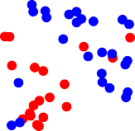
Earlier we mentioned that a single perceptron cannot deal with this data because it is not linearly separable
12/62
CS7015 (Deep Learning) : Lecture 3

Slide 34
Earlier we mentioned that a single perceptron cannot deal with this data because it is not linearly separable
What does “cannot deal with” mean?
12/62
CS7015 (Deep Learning) : Lecture 3

Slide 35
Earlier we mentioned that a single perceptron cannot deal with this data because it is not linearly separable
What does “cannot deal with” mean?
What would happen if we use a perceptron model to classify this data ?
12/62
CS7015 (Deep Learning) : Lecture 3

Slide 36
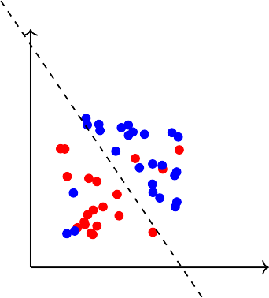
Earlier we mentioned that a single perceptron cannot deal with this data because it is not linearly separable
What does “cannot deal with” mean?
What would happen if we use a perceptron model to classify this data ?
We would probably end up with a line like this ...
12/62
CS7015 (Deep Learning) : Lecture 3

Slide 37
Earlier we mentioned that a single perceptron cannot deal with this data because it is not linearly separable
What does “cannot deal with” mean?
What would happen if we use a perceptron model to classify this data ?
We would probably end up with a line like this ... This line doesn’t seem to be too bad
12/62
CS7015 (Deep Learning) : Lecture 3

Slide 38
Earlier we mentioned that a single perceptron cannot deal with this data because it is not linearly separable
What does “cannot deal with” mean?
What would happen if we use a perceptron model to classify this data ?
We would probably end up with a line like this ... This line doesn’t seem to be too bad
Sure, it misclassifies 3 blue points and 3 red points but we could live with this error in most real world applications
12/62
CS7015 (Deep Learning) : Lecture 3

Slide 39
Earlier we mentioned that a single perceptron cannot deal with this data because it is not linearly separable
What does “cannot deal with” mean?
What would happen if we use a perceptron model to classify this data ?
We would probably end up with a line like this ... This line doesn’t seem to be too bad
Sure, it misclassifies 3 blue points and 3 red points but we could live with this error in most real world applications
From now on, we will accept that it is hard to drive the error to 0 in most cases and will instead aim to reach the minimum possible error
12/62
CS7015 (Deep Learning) : Lecture 3

Slide 40
This brings us to a typical machine learning setup which has the following components...
13/62
CS7015 (Deep Learning) : Lecture 3

Slide 41
This brings us to a typical machine learning setup which has the following components...
Data: {x , y }
n
i i
i=1
13/62
CS7015 (Deep Learning) : Lecture 3

Slide 42
This brings us to a typical machine learning setup which has the following components...
Data: {x , y }
n
i i
i=1
Model: Our approximation of the relation between x and y. For example,
13/62
CS7015 (Deep Learning) : Lecture 3

Slide 43
This brings us to a typical machine learning setup which has the following components...
Data: {x , y }
n
i i
i=1
Model: Our approximation of the relation between x and y. For example,
1
yˆ =
_{1 + e}−(w^{T}x)
13/62
CS7015 (Deep Learning) : Lecture 3

Slide 44
This brings us to a typical machine learning setup which has the following components...
Data: {x , y }
n
i i
i=1
Model: Our approximation of the relation between x and y. For example,
1
yˆ =
_{1 + e}−(w^{T}x)
or yˆ = w^{T}x
13/62
CS7015 (Deep Learning) : Lecture 3

Slide 45
This brings us to a typical machine learning setup which has the following components...
Data: {x , y }
n
i i
i=1
Model: Our approximation of the relation between x and y. For example,
1
yˆ =
_{1 + e}−(w^{T}x)
or yˆ = w^{T}x
or yˆ = x^{T}Wx
13/62
CS7015 (Deep Learning) : Lecture 3

Slide 46
This brings us to a typical machine learning setup which has the following components...
Data: {x , y }
n
i i
i=1
Model: Our approximation of the relation between x and y. For example,
1
yˆ =
_{1 + e}−(w^{T}x)
or yˆ = w^{T}x
or yˆ = x^{T}Wx
or just about any function
13/62
CS7015 (Deep Learning) : Lecture 3

Slide 47
This brings us to a typical machine learning setup which has the following components...
Data: {x , y }
n
i i
i=1
Model: Our approximation of the relation between x and y. For example,
1
yˆ =
_{1 + e}−(w^{T}x)
or yˆ = w^{T}x
or yˆ = x^{T}Wx
or just about any function
Parameters: In all the above cases, w is a parameter which needs to be learned from the data
13/62
CS7015 (Deep Learning) : Lecture 3

Slide 48
This brings us to a typical machine learning setup which has the following components...
Data: {x , y }
n
i i
i=1
Model: Our approximation of the relation between x and y. For example,
1
yˆ =
_{1 + e}−(w^{T}x)
or yˆ = w^{T}x
or yˆ = x^{T}Wx
or just about any function
Parameters: In all the above cases, w is a parameter which needs to be learned from the data
Learning algorithm: An algorithm for learning the parameters (w) of the model (for example, perceptron learning algorithm, gradient descent, etc.)
13/62
CS7015 (Deep Learning) : Lecture 3

Slide 49
This brings us to a typical machine learning setup which has the following components...
Data: {x , y }
n
i i
i=1
Model: Our approximation of the relation between x and y. For example,
1
yˆ =
_{1 + e}−(w^{T}x)
or yˆ = w^{T}x
or yˆ = x^{T}Wx
or just about any function
Parameters: In all the above cases, w is a parameter which needs to be learned from the data
Learning algorithm: An algorithm for learning the parameters (w) of the model (for example, perceptron learning algorithm, gradient descent, etc.) Objective/Loss/Error function: To guide the learning algorithm
13/62
CS7015 (Deep Learning) : Lecture 3

Slide 50
This brings us to a typical machine learning setup which has the following components...
Data: {x , y }
n
i i
i=1
Model: Our approximation of the relation between x and y. For example,
1
yˆ =
_{1 + e}−(w^{T}x)
or yˆ = w^{T}x
or yˆ = x^{T}Wx
or just about any function
Parameters: In all the above cases, w is a parameter which needs to be learned from the data
Learning algorithm: An algorithm for learning the parameters (w) of the model (for example, perceptron learning algorithm, gradient descent, etc.) Objective/Loss/Error function: To guide the learning algorithm - the learn- ing algorithm should aim to minimize the loss function
13/62
CS7015 (Deep Learning) : Lecture 3

Slide 51
As an illustration, consider our movie example
14/62
CS7015 (Deep Learning) : Lecture 3

Slide 52
As an illustration, consider our movie example
n
Data: {x = movie, y = like/dislike}
i
i
i=1
14/62
CS7015 (Deep Learning) : Lecture 3

Slide 53
As an illustration, consider our movie example
Data: {x = movie, y = like/dislike}
n
i i
i=1
Model: Our approximation of the relation between x and y (the probability of liking a movie).
14/62
CS7015 (Deep Learning) : Lecture 3

Slide 54
As an illustration, consider our movie example
Data: {x = movie, y = like/dislike}
n
i i
i=1
Model: Our approximation of the relation between x and y (the probability of liking a movie).
1
yˆ =
_{1 + e}−(w^{T}x)
14/62
CS7015 (Deep Learning) : Lecture 3

Slide 55
As an illustration, consider our movie example
Data: {x = movie, y = like/dislike}
n
i i
i=1
Model: Our approximation of the relation between x and y (the probability of liking a movie).
1
yˆ =
_{1 + e}−(w^{T}x)
Parameter: w
14/62
CS7015 (Deep Learning) : Lecture 3

Slide 56
As an illustration, consider our movie example
Data: {x = movie, y = like/dislike}
n
i i
i=1
Model: Our approximation of the relation between x and y (the probability of liking a movie).
1
yˆ =
_{1 + e}−(w^{T}x)
Parameter: w
Learning algorithm: Gradient Descent [we will see soon]
14/62
CS7015 (Deep Learning) : Lecture 3

Slide 57
As an illustration, consider our movie example
Data: {x = movie, y = like/dislike}
n
i i
i=1
Model: Our approximation of the relation between x and y (the probability of liking a movie).
1
yˆ =
_{1 + e}−(w^{T}x)
Parameter: w
Learning algorithm: Gradient Descent [we will see soon]
Objective/Loss/Error function:
14/62
CS7015 (Deep Learning) : Lecture 3

Slide 58
As an illustration, consider our movie example
Data: {x = movie, y = like/dislike}
n
i i
i=1
Model: Our approximation of the relation between x and y (the probability of liking a movie).
1
yˆ =
_{1 + e}−(w^{T}x)
Parameter: w
Learning algorithm: Gradient Descent [we will see soon]
Objective/Loss/Error function: One possibility is
n
Σ
L (w) = (yˆ − y )
2
i i
i=1
14/62
CS7015 (Deep Learning) : Lecture 3

Slide 59
As an illustration, consider our movie example
Data: {x = movie, y = like/dislike}
n
i i
i=1
Model: Our approximation of the relation between x and y (the probability of liking a movie).
1
yˆ =
_{1 + e}−(w^{T}x)
Parameter: w
Learning algorithm: Gradient Descent [we will see soon]
Objective/Loss/Error function: One possibility is
n
Σ
L (w) = (yˆ − y )
2
i i
i=1
The learning algorithm should aim to find a w which minimizes the above function (squared error between y and yˆ)
14/62
CS7015 (Deep Learning) : Lecture 3

Slide 60
Module 3.3: Learning Parameters: (Infeasible) guess work
15/62
CS7015 (Deep Learning) : Lecture 3

Slide 61
y
Keeping this supervised ML setup in mind, we will now focus on this model and discuss an algorithm for learning the parameters of this model from some given data using an appropriate objective function
σ
w₀ = −θ
x₀ = 1
w₁ w₂
.. ..
w_{n}
x₁ x₂
..
..
x_{n}
f (x) = ¹
_{1+e}−(w·x+b)
16/62
CS7015 (Deep Learning) : Lecture 3

Slide 62
Keeping this supervised ML setup in mind, we will now focus on this model and discuss an algorithm for learning the parameters of this model from some given data using an appropriate objective function
y
σ
σ stands for the sigmoid function (logistic function in this case)
w₀ = −θ
x₀ = 1
w₁ w₂
.. ..
w_{n}
x₁ x₂
..
..
x_{n}
f (x) = ¹
_{1+e}−(w·x+b)
16/62
CS7015 (Deep Learning) : Lecture 3

Slide 63
Keeping this supervised ML setup in mind, we will now focus on this model and discuss an algorithm for learning the parameters of this model from some given data using an appropriate objective function
x
σ
yˆ = f (x)
1
f (x) = ¹
_{1+e}−(w·x+b)
σ stands for the sigmoid function (logistic function in this case)
For ease of explanation, we will consider a very simplified version of the model having just 1 input
16/62
CS7015 (Deep Learning) : Lecture 3

Slide 64
Keeping this supervised ML setup in mind, we will now focus on this model and discuss an algorithm for learning the parameters of this model from some given data using an appropriate objective function
x
w b
σ
yˆ = f (x)
1
f (x) = ¹
_{1+e}−(w·x+b)
σ stands for the sigmoid function (logistic function in this case)
For ease of explanation, we will consider a very simplified version of the model having just 1 input
Further to be consistent with the literature, from now on, we will refer to w₀ as b (bias)
16/62
CS7015 (Deep Learning) : Lecture 3

Slide 65
Keeping this supervised ML setup in mind, we will now focus on this model and discuss an algorithm for learning the parameters of this model from some given data using an appropriate objective function
x
w b
σ
yˆ = f (x)
1
f (x) = ¹
_{1+e}−(w·x+b)
σ stands for the sigmoid function (logistic function in this case)
For ease of explanation, we will consider a very simplified version of the model having just 1 input
Further to be consistent with the literature, from now on, we will refer to w₀ as b (bias)
Lastly, instead of considering the problem of predicting like/dislike, we will assume that we want to predict criticsRating(y) given imdbRating(x) (for no particular reason)
16/62
CS7015 (Deep Learning) : Lecture 3

Slide 66
x
w b
σ
yˆ = f (x)
1
f (x) = ¹
_{1+e}−(w·x+b)
17/62
CS7015 (Deep Learning) : Lecture 3

Slide 67
x
w b
σ
yˆ = f (x)
Input for training
N
1
{x , y } → N pairs of (x, y)
i i
i=1
f (x) = ¹
_{1+e}−(w·x+b)
17/62
CS7015 (Deep Learning) : Lecture 3

Slide 68
yˆ = f (x)
x
w b
σ
Input for training
N
1
{x , y } → N pairs of (x, y)
i i
i=1
f (x) = ¹
Training objective
_{1+e}−(w·x+b)
Find w and b such that:
N
Σ
minimize L (w, b) = (y − f (x ))
2
i i
w,b
i=1
17/62
CS7015 (Deep Learning) : Lecture 3

Slide 69
yˆ = f (x)
x
w b
σ
Input for training
N
1
{x , y } → N pairs of (x, y)
i i
i=1
f (x) = ¹
Training objective
_{1+e}−(w·x+b)
Find w and b such that:
N
Σ
minimize L (w, b) = (y − f (x ))
2
i i
w,b
i=1
17/62
CS7015 (Deep Learning) : Lecture 3

Slide 70
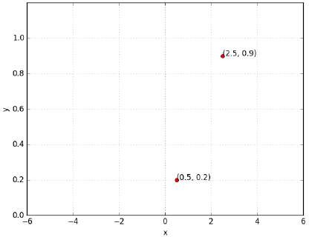
yˆ = f (x)
x
w b
σ
What does it mean to train the network?
1
Suppose we train the network with (x, y) = (0.5, 0.2) and (2.5, 0.9)
f (x) = ¹
_{1+e}−(w·x+b)
17/62
CS7015 (Deep Learning) : Lecture 3

Slide 71
yˆ = f (x)
x
w b
σ
What does it mean to train the network?
1
Suppose we train the network with (x, y) = (0.5, 0.2) and (2.5, 0.9)
At the end of training we expect to find w*, b* such that:
f (x) = ¹
_{1+e}−(w·x+b)
17/62
CS7015 (Deep Learning) : Lecture 3

Slide 72
yˆ = f (x)
x
w b
σ
What does it mean to train the network?
1
Suppose we train the network with (x, y) = (0.5, 0.2) and (2.5, 0.9)
At the end of training we expect to find w*, b* such that:
f (0.5) → 0.2 and f (2.5) → 0.9
f (x) = ¹
_{1+e}−(w·x+b)
17/62
CS7015 (Deep Learning) : Lecture 3

Slide 73
yˆ = f (x)
x
w b
σ
What does it mean to train the network?
1
Suppose we train the network with (x, y) = (0.5, 0.2) and (2.5, 0.9)
At the end of training we expect to find w*, b* such that:
f (0.5) → 0.2 and f (2.5) → 0.9
f (x) = ¹
_{1+e}−(w·x+b)
In other words...
We hope to find a sigmoid function such that (0.5, 0.2) and (2.5, 0.9) lie on this sigmoid
17/62
CS7015 (Deep Learning) : Lecture 3

Slide 74
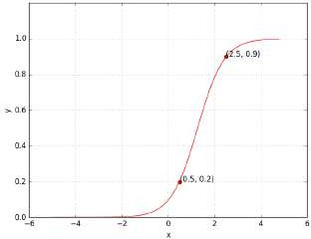
yˆ = f (x)
x
w b
σ
What does it mean to train the network?
1
Suppose we train the network with (x, y) = (0.5, 0.2) and (2.5, 0.9)
At the end of training we expect to find w*, b* such that:
f (0.5) → 0.2 and f (2.5) → 0.9
f (x) = ¹
_{1+e}−(w·x+b)
In other words...
We hope to find a sigmoid function such that (0.5, 0.2) and (2.5, 0.9) lie on this sigmoid
17/62
CS7015 (Deep Learning) : Lecture 3

Slide 75
Let us see this in more detail....
18/62
CS7015 (Deep Learning) : Lecture 3

Slide 76
1
σ(x) =
_{1 + e}−(wx+b)
19/62
CS7015 (Deep Learning) : Lecture 3

Slide 77
Can we try to find such a w∗, b∗ manually
1
σ(x) =
_{1 + e}−(wx+b)
19/62
CS7015 (Deep Learning) : Lecture 3

Slide 78
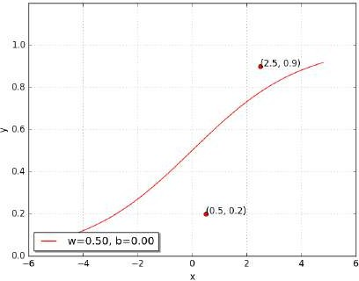
Can we try to find such a w∗, b∗ manually
Let us try a random guess.. (say, w = 0.5, b = 0)
1
σ(x) =
_{1 + e}−(wx+b)
19/62
CS7015 (Deep Learning) : Lecture 3

Slide 79
Can we try to find such a w∗, b∗ manually
Let us try a random guess.. (say, w = 0.5, b = 0) Clearly not good, but how bad is it ?
1
σ(x) =
_{1 + e}−(wx+b)
19/62
CS7015 (Deep Learning) : Lecture 3

Slide 80
Can we try to find such a w∗, b∗ manually
Let us try a random guess.. (say, w = 0.5, b = 0) Clearly not good, but how bad is it ?
Let us revisit L (w, b) to see how bad it is ...
1
σ(x) =
_{1 + e}−(wx+b)
19/62
CS7015 (Deep Learning) : Lecture 3

Slide 81
N
1
Σ
L (w, b) = ∗ (y − f (x ))
2
2
i i
i=1
1
σ(x) =
_{1 + e}−(wx+b)
19/62
CS7015 (Deep Learning) : Lecture 3

Slide 82
N
1
Σ
L (w, b) = ∗ (y − f (x ))
2
2
i i
i=1
1
2 2
= ∗ (y − f (x )) + (y − f (x ))
2
1 1 2
2
1
σ(x) =
_{1 + e}−(wx+b)
19/62
CS7015 (Deep Learning) : Lecture 3

Slide 83
N
1
Σ
L (w, b) = ∗ (y − f (x ))
2
2
i i
i=1
1
2 2
= ∗ (y − f (x )) + (y − f (x ))
2
1 1 2 2
1
2
2
= ∗ (0.9 − f (2.5)) + (0.2 − f (0.5))
2
1
σ(x) =
_{1 + e}−(wx+b)
19/62
CS7015 (Deep Learning) : Lecture 3

Slide 84
N
1
Σ
L (w, b) = ∗ (y − f (x ))
2
2
i i
i=1
1
2 2
= ∗ (y − f (x )) + (y − f (x ))
2
1 1 2 2
1
2
2
= ∗ (0.9 − f (2.5)) + (0.2 − f (0.5))
2
= 0.073
1
σ(x) =
_{1 + e}−(wx+b)
19/62
CS7015 (Deep Learning) : Lecture 3

Slide 85
N
1
Σ
L (w, b) = ∗ (y − f (x ))
2
2
i i
i=1
1
2 2
= ∗ (y − f (x )) + (y − f (x ))
2
1 1 2 2
1
2
2
= ∗ (0.9 − f (2.5)) + (0.2 − f (0.5))
2
= 0.073
1
We want L (w, b) to be as close to 0 as possible
σ(x) =
_{1 + e}−(wx+b)
19/62
CS7015 (Deep Learning) : Lecture 3

Slide 86
Let us try some other values of w, b
w b L (w, b) 0.50 0.00 0.0730
1
σ(x) =
_{1 + e}−(wx+b)
19/62
CS7015 (Deep Learning) : Lecture 3

Slide 87
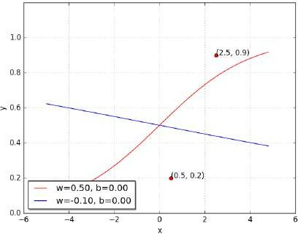
Let us try some other values of w, b
w | b | L (w, b)
0.50 | 0.00 | 0.0730
-0.10 | 0.00 | 0.1481
1
σ(x) =
Oops!! this made things even worse...
_{1 + e}−(wx+b)
19/62
CS7015 (Deep Learning) : Lecture 3

Slide 88
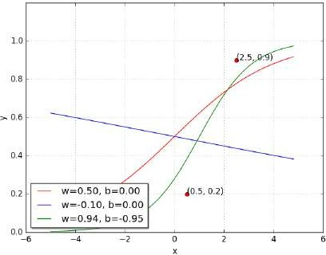
Let us try some other values of w, b
w | b | L (w, b)
0.50 | 0.00 | 0.0730
-0.10 | 0.00 | 0.1481
0.94 | -0.94 | 0.0214
1
Perhaps it would help to push w and b in the other direction...
σ(x) =
_{1 + e}−(wx+b)
19/62
CS7015 (Deep Learning) : Lecture 3

Slide 89
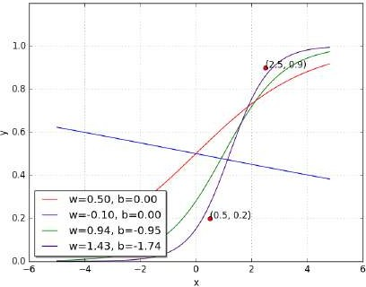
Let us try some other values of w, b
w | b | L (w, b)
0.50 | 0.00 | 0.0730
-0.10 | 0.00 | 0.1481
0.94 | -0.94 | 0.0214
1.42 | -1.73 | 0.0028
1
Let us keep going in this direction, i.e., increase
w and decrease b
σ(x) =
_{1 + e}−(wx+b)
19/62
CS7015 (Deep Learning) : Lecture 3

Slide 90
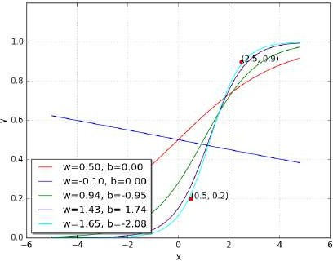
Let us try some other values of w, b
w | b | L (w, b)
0.50 | 0.00 | 0.0730
-0.10 | 0.00 | 0.1481
0.94 | -0.94 | 0.0214
1.42 | -1.73 | 0.0028
1.65 | -2.08 | 0.0003
1
Let us keep going in this direction, i.e., increase
w and decrease b
σ(x) =
_{1 + e}−(wx+b)
19/62
CS7015 (Deep Learning) : Lecture 3

Slide 91
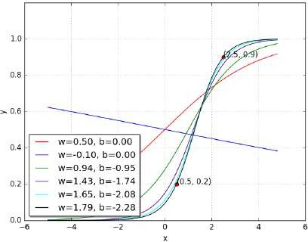
Let us try some other values of w, b
w | b | L (w, b)
0.50 | 0.00 | 0.0730
-0.10 | 0.00 | 0.1481
0.94 | -0.94 | 0.0214
1.42 | -1.73 | 0.0028
1.65 | -2.08 | 0.0003
1.78 | -2.27 | 0.0000
1
With some guess work and intuition we were able to find the right values for w and b
σ(x) =
_{1 + e}−(wx+b)
19/62
CS7015 (Deep Learning) : Lecture 3

Slide 92
Let us look at something better than our “guess work” algorithm....
20/62
CS7015 (Deep Learning) : Lecture 3

Slide 93
Since we have only 2 points and 2 parameters (w, b) we can easily plot L (w, b) for different values of (w, b) and pick the one where L (w, b) is minimum
21/62
CS7015 (Deep Learning) : Lecture 3

Slide 94
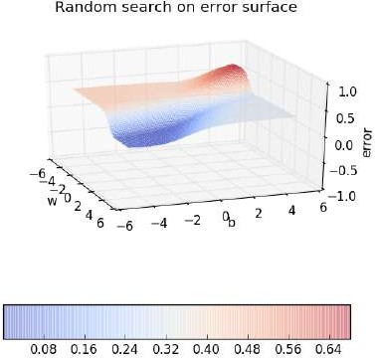
Since we have only 2 points and 2 parameters (w, b) we can easily plot L (w, b) for different values of (w, b) and pick the one where L (w, b) is minimum
21/62
CS7015 (Deep Learning) : Lecture 3

Slide 95
Since we have only 2 points and 2 parameters (w, b) we can easily plot L (w, b) for different values of (w, b) and pick the one where L (w, b) is minimum
But of course this becomes intract- able once you have many more data points and many more parameters !!
21/62
CS7015 (Deep Learning) : Lecture 3

Slide 96
Since we have only 2 points and 2 parameters (w, b) we can easily plot L (w, b) for different values of (w, b) and pick the one where L (w, b) is minimum
But of course this becomes intract- able once you have many more data points and many more parameters !!
Further, even here we have plotted the error surface only for a small range of (w, b) [from (−6, 6) and not from (− inf, inf)]
21/62
CS7015 (Deep Learning) : Lecture 3

Slide 97
Let us look at the geometric interpretation of our “guess work” algorithm in terms of this error surface
22/62
CS7015 (Deep Learning) : Lecture 3

Slide 98
23/62
CS7015 (Deep Learning) : Lecture 3

Slide 99
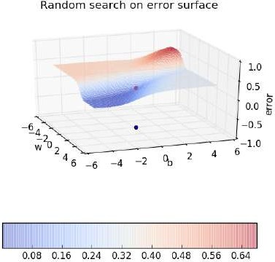
23/62
CS7015 (Deep Learning) : Lecture 3

Slide 100

23/62
CS7015 (Deep Learning) : Lecture 3

Slide 101

23/62
CS7015 (Deep Learning) : Lecture 3

Slide 102

23/62
CS7015 (Deep Learning) : Lecture 3

Slide 103
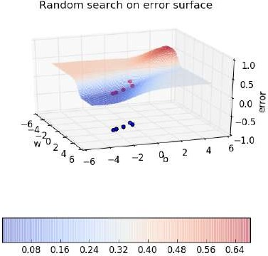
23/62
CS7015 (Deep Learning) : Lecture 3

Slide 104

23/62
CS7015 (Deep Learning) : Lecture 3

Slide 105
Module 3.4: Learning Parameters : Gradient Descent
24/62
CS7015 (Deep Learning) : Lecture 3

Slide 106
Now let us see if there is a more efficient and principled way of doing this
25/62
CS7015 (Deep Learning) : Lecture 3

Slide 107
Goal
Find a better way of traversing the error surface so that we can reach the minimum value quickly without resorting to brute force search!
26/62
CS7015 (Deep Learning) : Lecture 3

Slide 108
vector of parameters, say, randomly initial- ized
θ = [w, b]
27/62
CS7015 (Deep Learning) : Lecture 3

Slide 109
vector of parameters, say, randomly initial- ized
θ = [w, b]
∆θ = [∆w, ∆b]
change in the values of w, b
27/62
CS7015 (Deep Learning) : Lecture 3

Slide 110
vector of parameters, say, randomly initial- ized
θ = [w, b]
θ
∆θ = [∆w, ∆b]
∆θ
change in the
values of w, b
27/62
CS7015 (Deep Learning) : Lecture 3

Slide 111
vector of parameters, say, randomly initial- ized
θ = [w, b]
θ
θnew
∆θ = [∆w, ∆b]
∆θ
change in the
values of w, b
27/62
CS7015 (Deep Learning) : Lecture 3

Slide 112
vector of parameters, say, randomly initial- ized
θ = [w, b]
We moved in the direc- tion of ∆θ
θ
θnew
∆θ = [∆w, ∆b]
∆θ
change in the
values of w, b
27/62
CS7015 (Deep Learning) : Lecture 3

Slide 113
vector of parameters, say, randomly initial- ized
θ = [w, b]
We moved in the direc- tion of ∆θ
θ
θnew
∆θ = [∆w, ∆b]
∆θ
Let us be a bit conservat- ive: move only by a small amount η
change in the values of w, b
27/62
CS7015 (Deep Learning) : Lecture 3

Slide 114
vector of parameters, say, randomly initial- ized
θ = [w, b]
We moved in the direc- tion of ∆θ
θ
θnew
∆θ = [∆w, ∆b]
η · ∆θ ∆θ
Let us be a bit conservat- ive: move only by a small amount η
change in the values of w, b
27/62
CS7015 (Deep Learning) : Lecture 3

Slide 115
vector of parameters, say, randomly initial- ized
θ = [w, b]
We moved in the direc- tion of ∆θ
θ
θnew
∆θ = [∆w, ∆b]
η · ∆θ ∆θ
Let us be a bit conservat- ive: move only by a small amount η
change in the values of w, b
27/62
CS7015 (Deep Learning) : Lecture 3

Slide 116
vector of parameters, say, randomly initial- ized
θ = [w, b]
We moved in the direc- tion of ∆θ
θ
θnew
∆θ = [∆w, ∆b]
η · ∆θ ∆θ
Let us be a bit conservat- ive: move only by a small amount η
change in the values of w, b
θ_{new} = θ + η · ∆θ
27/62
CS7015 (Deep Learning) : Lecture 3

Slide 117
vector of parameters, say, randomly initial- ized
θ = [w, b]
We moved in the direc- tion of ∆θ
θ
θnew
∆θ = [∆w, ∆b]
η · ∆θ ∆θ
Let us be a bit conservat- ive: move only by a small amount η
change in the values of w, b
θ_{new} = θ + η · ∆θ
Question: What is the right ∆θ to use
?
27/62
CS7015 (Deep Learning) : Lecture 3

Slide 118
vector of parameters, say, randomly initial- ized
θ = [w, b]
We moved in the direc- tion of ∆θ
θ
θnew
∆θ = [∆w, ∆b]
η · ∆θ ∆θ
Let us be a bit conservat- ive: move only by a small amount η
change in the values of w, b
θ_{new} = θ + η · ∆θ
Question: What is the right ∆θ to use
?
The answer comes from Taylor series
27/62
CS7015 (Deep Learning) : Lecture 3

Slide 119
For ease of notation, let ∆θ = u, then from Taylor series, we have,
28/62
CS7015 (Deep Learning) : Lecture 3

Slide 120
For ease of notation, let ∆θ = u, then from Taylor series, we have,
_{η}2 _{η}3 _{η}4
T T 2
L (θ + ηu) = L (θ) + η ∗ u ∇_{θ} L (θ) + _{2!} ∗ u ∇ L (θ)u + _{3!} ∗ ... + _{4!} ∗ ...
28/62
CS7015 (Deep Learning) : Lecture 3

Slide 121
For ease of notation, let ∆θ = u, then from Taylor series, we have,
_{η}2 _{η}3 _{η}4
T T 2
L (θ + ηu) = L (θ) + η ∗ u ∇_{θ} L (θ) + _{2!} ∗ u ∇ L (θ)u + _{3!} ∗ ... + _{4!} ∗ ...
T 2 3
= L (θ) + η ∗ u ∇_{θ} L (θ) [η is typically small, so η , η , .. → 0]
28/62
CS7015 (Deep Learning) : Lecture 3

Slide 122
For ease of notation, let ∆θ = u, then from Taylor series, we have,
_{η}2 _{η}3 _{η}4
T T 2
L (θ + ηu) = L (θ) + η ∗ u ∇_{θ} L (θ) + _{2!} ∗ u ∇ L (θ)u + _{3!} ∗ ... + _{4!} ∗ ...
T 2 3
= L (θ) + η ∗ u ∇_{θ} L (θ) [η is typically small, so η , η , .. → 0]
Note that the move (ηu) would be favorable only if,
L (θ + ηu) − L (θ) < 0 [i.e., if the new loss is less than the previous loss]
28/62
CS7015 (Deep Learning) : Lecture 3

Slide 123
For ease of notation, let ∆θ = u, then from Taylor series, we have,
_{η}2 _{η}3 _{η}4
T T 2
L (θ + ηu) = L (θ) + η ∗ u ∇_{θ} L (θ) + _{2!} ∗ u ∇ L (θ)u + _{3!} ∗ ... + _{4!} ∗ ...
T 2 3
= L (θ) + η ∗ u ∇_{θ} L (θ) [η is typically small, so η , η , .. → 0]
Note that the move (ηu) would be favorable only if,
L (θ + ηu) − L (θ) < 0 [i.e., if the new loss is less than the previous loss]
This implies,
u^{T} ∇_{θ} L (θ) < 0
28/62
CS7015 (Deep Learning) : Lecture 3

Slide 124
Okay, so we have,
u^{T} ∇_{θ} L (θ) < 0 But, what is the range of u^{T} ∇_{θ} L (θ) ?
29/62
CS7015 (Deep Learning) : Lecture 3

Slide 125
Okay, so we have,
u^{T} ∇_{θ} L (θ) < 0 But, what is the range of u^{T} ∇_{θ} L (θ) ? Let us see....
29/62
CS7015 (Deep Learning) : Lecture 3

Slide 126
Okay, so we have,
u^{T} ∇_{θ} L (θ) < 0 But, what is the range of u^{T} ∇_{θ} L (θ) ? Let us see....
Let β be the angle between u and ∇_{θ} L (θ), then we know that,
29/62
CS7015 (Deep Learning) : Lecture 3

Slide 127
Okay, so we have,
u^{T} ∇_{θ} L (θ) < 0 But, what is the range of u^{T} ∇_{θ} L (θ) ? Let us see....
Let β be the angle between u and ∇_{θ} L (θ), then we know that,
u^{T} ∇_{θ} L (θ)
— 1 ≤ cos(β) =
≤ 1
||u|| ∗ ||∇ L (θ)||
θ
29/62
CS7015 (Deep Learning) : Lecture 3

Slide 128
Okay, so we have,
u^{T} ∇_{θ} L (θ) < 0 But, what is the range of u^{T} ∇_{θ} L (θ) ? Let us see....
Let β be the angle between u and ∇_{θ} L (θ), then we know that,
u^{T} ∇_{θ} L (θ)
— 1 ≤ cos(β) =
≤ 1
||u|| ∗ ||∇ L (θ)||
θ
29/62
CS7015 (Deep Learning) : Lecture 3

Slide 129
Okay, so we have,
u^{T} ∇_{θ} L (θ) < 0 But, what is the range of u^{T} ∇_{θ} L (θ) ? Let us see....
Let β be the angle between u and ∇_{θ} L (θ), then we know that,
u^{T} ∇_{θ} L (θ)
— 1 ≤ cos(β) =
≤ 1
||u|| ∗ ||∇ L (θ)||
θ
multiply throughout by k = ||u|| ∗ ||∇_{θ} L (θ)||
T
— k ≤ k ∗ cos(β) = u ∇_{θ} L (θ) ≤ k
29/62
CS7015 (Deep Learning) : Lecture 3

Slide 130
Okay, so we have,
u^{T} ∇_{θ} L (θ) < 0 But, what is the range of u^{T} ∇_{θ} L (θ) ? Let us see....
Let β be the angle between u and ∇_{θ} L (θ), then we know that,
u^{T} ∇_{θ} L (θ)
— 1 ≤ cos(β) =
≤ 1
||u|| ∗ ||∇ L (θ)||
θ
multiply throughout by k = ||u|| ∗ ||∇_{θ} L (θ)||
T
— k ≤ k ∗ cos(β) = u ∇_{θ} L (θ) ≤ k
Thus, L (θ + ηu) − L (θ) = u^{T} ∇_{θ} L (θ) = k ∗ cos(β) will be most negative when
cos(β) = −1 i.e., when β is 180°
29/62
CS7015 (Deep Learning) : Lecture 3

Slide 131
Gradient Descent Rule
The direction u that we intend to move in should be at 180° w.r.t. the gradient
30/62
CS7015 (Deep Learning) : Lecture 3

Slide 132
Gradient Descent Rule
The direction u that we intend to move in should be at 180° w.r.t. the gradient In other words, move in a direction opposite to the gradient
30/62
CS7015 (Deep Learning) : Lecture 3

Slide 133
Gradient Descent Rule
The direction u that we intend to move in should be at 180° w.r.t. the gradient
In other words, move in a direction opposite to the gradient
Parameter Update Equations
w_{t+1} = w_{t} − η∇w_{t} b_{t+1} = b_{t} − η∇b_{t}
∂L (w, b)
∂L (w, b)
∂b
where, ∇w =
, ∇b =
t
∂w at w = w , b = b
t t
at w = w , b = b
t t
30/62
CS7015 (Deep Learning) : Lecture 3

Slide 134
Gradient Descent Rule
The direction u that we intend to move in should be at 180° w.r.t. the gradient
In other words, move in a direction opposite to the gradient
Parameter Update Equations
w_{t+1} = w_{t} − η∇w_{t} b_{t+1} = b_{t} − η∇b_{t}
∂L (w, b)
∂L (w, b)
∂b
where, ∇w =
, ∇b =
t
∂w at w = w , b = b
t t
at w = w , b = b
t t
So we now have a more principled way of moving in the w-b plane than our “guess work” algorithm
30/62
CS7015 (Deep Learning) : Lecture 3

Slide 135
Let us create an algorithm from this rule ...
31/62
CS7015 (Deep Learning) : Lecture 3

Slide 136
Let us create an algorithm from this rule ...
Algorithm: gradient descent()
t ← 0;
max iterations ← 1000;
while t < max iterations do
w_{t+1} ← w_{t} − η∇w_{t}; b_{t+1} ← b_{t} − η∇b_{t};
t ← t + 1;
end
31/62
CS7015 (Deep Learning) : Lecture 3

Slide 137
Let us create an algorithm from this rule ...
Algorithm: gradient descent()
t ← 0;
max iterations ← 1000;
while t < max iterations do
w_{t+1} ← w_{t} − η∇w_{t}; b_{t+1} ← b_{t} − η∇b_{t};
t ← t + 1;
end
To see this algorithm in practice let us first derive ∇w and ∇b for our toy neural network
31/62
CS7015 (Deep Learning) : Lecture 3

Slide 138
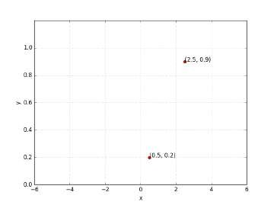
x
σ
y = f (x)
1
f (x) = ¹
_{1+e}−(w·x+b)
32/62
CS7015 (Deep Learning) : Lecture 3

Slide 139
x
σ
y = f (x)
1
Let’s assume there is only 1 point to fit (x, y)
f (x) = ¹
_{1+e}−(w·x+b)
32/62
CS7015 (Deep Learning) : Lecture 3

Slide 140
x
σ
y = f (x)
1
Let’s assume there is only 1 point to fit (x, y)
f (x) = ¹
_{1+e}−(w·x+b)
1
L (w, b) = ∗ (f (x) − y)
2
2
32/62
CS7015 (Deep Learning) : Lecture 3

Slide 141
x
σ
y = f (x)
1
Let’s assume there is only 1 point to fit (x, y)
f (x) = ¹
_{1+e}−(w·x+b)
1
L (w, b) = ∗ (f (x) − y)
2
2
∂L (w, b) ∂ 1
∇w =
2
= [ ∗ (f (x) − y) ]
∂w ∂w 2
32/62
CS7015 (Deep Learning) : Lecture 3

Slide 142
∂ 1
2
∇w = [ ∗ (f (x) − y) ]
∂w 2
33/62
CS7015 (Deep Learning) : Lecture 3

Slide 143
∂ 1
2
∇w = [ ∗ (f (x) − y) ]
∂w 2
1 ∂
= ∗ [2 ∗ (f (x) − y) ∗ (f (x) − y)]
2 ∂w
33/62
CS7015 (Deep Learning) : Lecture 3

Slide 144
∂ 1
2
∇w = [ ∗ (f (x) − y) ]
∂w 2
1 ∂
= ∗ [2 ∗ (f (x) − y) ∗ (f (x) − y)]
2 ∂w
= (f (x) − y) ∗ _{∂w} (f (x))
∂
33/62
CS7015 (Deep Learning) : Lecture 3

Slide 145
∂ 1
2
∇w = [ ∗ (f (x) − y) ]
∂w 2
1 ∂
= ∗ [2 ∗ (f (x) − y) ∗ (f (x) − y)]
2 ∂w
= (f (x) − y) ∗ _{∂w} (f (x))
∂
∂
1
= (f (x) − y) ∗
_{1 + e}−(wx+b)
∂w
33/62
CS7015 (Deep Learning) : Lecture 3

Slide 146
∂ 1
∂
1
2
∇w = [ ∗ (f (x) − y) ]
_{1 + e}−(wx+b)
∂w 2
∂w
1 ∂
= ∗ [2 ∗ (f (x) − y) ∗ (f (x) − y)]
2 ∂w
= (f (x) − y) ∗ _{∂w} (f (x))
∂
∂
1
= (f (x) − y) ∗
_{1 + e}−(wx+b)
∂w
33/62
CS7015 (Deep Learning) : Lecture 3

Slide 147
∂ 1
∂
1
2
∇w = [ ∗ (f (x) − y) ]
_{1 + e}−(wx+b)
∂w 2
∂w
1
∂
−1 ∂
_{= (e}−(wx+b)₎₎
= ∗ [2 ∗ (f (x) − y) ∗ (f (x) − y)]
2 ∂w
_{(1 + e}−(wx+b)₎2 _{∂w}
∂
= (f (x) − y) ∗ _{∂w} (f (x))
∂
1
= (f (x) − y) ∗
_{1 + e}−(wx+b)
∂w
33/62
CS7015 (Deep Learning) : Lecture 3

Slide 148
∂ 1
∂
1
2
∇w = [ ∗ (f (x) − y) ]
_{1 + e}−(wx+b)
∂w 2
∂w
1
∂
−1 ∂
_{= (e}−(wx+b)₎₎
= ∗ [2 ∗ (f (x) − y) ∗ (f (x) − y)]
2 ∂w
_{(1 + e}−(wx+b)₎2 _{∂w}
∂
−1
= (f (x) − y) ∗ (f (x))
= ∗ (e
_{(1 + e}−(wx+b)₎2
−(wx+b) ∂
) (−(wx + b)))
∂w
∂w
∂
1
= (f (x) − y) ∗
_{1 + e}−(wx+b)
∂w
33/62
CS7015 (Deep Learning) : Lecture 3

Slide 149
∂ 1
∂
1
2
∇w = [ ∗ (f (x) − y) ]
_{1 + e}−(wx+b)
∂w 2
∂w
1
∂
−1 ∂
_{= (e}−(wx+b)₎₎
= ∗ [2 ∗ (f (x) − y) ∗ (f (x) − y)]
2 ∂w
_{(1 + e}−(wx+b)₎2 _{∂w}
∂
−1
= (f (x) − y) ∗ (f (x))
= ∗ (e
_{(1 + e}−(wx+b)₎2
−(wx+b) ∂
) (−(wx + b)))
∂w
∂w
∂ 1
= (f (x) − y) ∗
−1
_{e}−(wx+b)
∂w
_{1 + e}−(wx+b)
=
∗
∗ (−x)
_{(1 + e}−(wx+b)_{) (1 + e}−(wx+b)₎
33/62
CS7015 (Deep Learning) : Lecture 3

Slide 150
∂ 1
∂
1
2
∇w = [ ∗ (f (x) − y) ]
_{1 + e}−(wx+b)
∂w 2
∂w
1
∂
−1 ∂
_{= (e}−(wx+b)₎₎
= ∗ [2 ∗ (f (x) − y) ∗ (f (x) − y)]
2 ∂w
_{(1 + e}−(wx+b)₎2 _{∂w}
∂
−1
= (f (x) − y) ∗ (f (x))
= ∗ (e
_{(1 + e}−(wx+b)₎2
−(wx+b) ∂
) (−(wx + b)))
∂w
∂w
∂ 1
= (f (x) − y) ∗
−1
_{e}−(wx+b)
∂w
_{1 + e}−(wx+b)
=
∗ ∗ (−x)
_{(1 + e}−(wx+b)_{) (1 + e}−(wx+b)₎
1
_{e}−(wx+b)
= ∗ ∗ (x) _{(1 + e}−(wx+b)_{) (1 + e}−(wx+b)₎
33/62
CS7015 (Deep Learning) : Lecture 3

Slide 151
∂ 1
∂
1
2
∇w = [ ∗ (f (x) − y) ]
_{1 + e}−(wx+b)
∂w 2
∂w
1
∂
−1 ∂
_{= (e}−(wx+b)₎₎
= ∗ [2 ∗ (f (x) − y) ∗ (f (x) − y)]
2 ∂w
_{(1 + e}−(wx+b)₎2 _{∂w}
∂
−1
= (f (x) − y) ∗ (f (x))
= ∗ (e
_{(1 + e}−(wx+b)₎2
−(wx+b) ∂
) (−(wx + b)))
∂w
∂w
∂ 1
= (f (x) − y) ∗
−1
_{e}−(wx+b)
∂w
_{1 + e}−(wx+b)
=
∗ ∗ (−x)
_{(1 + e}−(wx+b)_{) (1 + e}−(wx+b)₎
=( f (x) − y) ∗ f (x) ∗ (1 − f (x)) ∗ x
1
_{e}−(wx+b)
= ∗ ∗ (x) _{(1 + e}−(wx+b)_{) (1 + e}−(wx+b)₎
= f (x) ∗ (1 − f (x)) ∗ x
33/62
CS7015 (Deep Learning) : Lecture 3

Slide 152
x
σ
y = f (x)
1
So if there is only 1 point (x, y), we have,
f (x) = ¹
_{1+e}−(w·x+b)
34/62
CS7015 (Deep Learning) : Lecture 3

Slide 153
x
σ
y = f (x)
1
So if there is only 1 point (x, y), we have,
f (x) = ¹
_{1+e}−(w·x+b)
∇w = (f (x) − y) ∗ f (x) ∗ (1 − f (x)) ∗ x
34/62
CS7015 (Deep Learning) : Lecture 3

Slide 154
x
σ
y = f (x)
1
So if there is only 1 point (x, y), we have,
f (x) = ¹
_{1+e}−(w·x+b)
∇w = (f (x) − y) ∗ f (x) ∗ (1 − f (x)) ∗ x
For two points,
34/62
CS7015 (Deep Learning) : Lecture 3

Slide 155
x
σ
y = f (x)
1
So if there is only 1 point (x, y), we have,
f (x) = ¹
_{1+e}−(w·x+b)
∇w = (f (x) − y) ∗ f (x) ∗ (1 − f (x)) ∗ x
For two points,
2
Σ
∇w = (f (x ) − y ) ∗ f (x ) ∗ (1 − f (x )) ∗ x
i i i i
i
i=1
34/62
CS7015 (Deep Learning) : Lecture 3

Slide 156
x
σ
y = f (x)
1
So if there is only 1 point (x, y), we have,
f (x) = ¹
_{1+e}−(w·x+b)
∇w = (f (x) − y) ∗ f (x) ∗ (1 − f (x)) ∗ x
For two points,
2
Σ
∇w = (f (x ) − y ) ∗ f (x ) ∗ (1 − f (x )) ∗ x
i i i i
i
i=1
2
Σ
∇b = (f (x ) − y ) ∗ f (x ) ∗ (1 − f (x ))
i i i i
i=1
34/62
CS7015 (Deep Learning) : Lecture 3

Slide 157
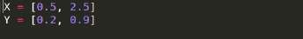
35/62
CS7015 (Deep Learning) : Lecture 3

Slide 158
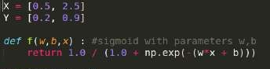
35/62
CS7015 (Deep Learning) : Lecture 3

Slide 159
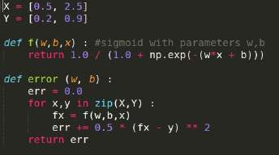
35/62
CS7015 (Deep Learning) : Lecture 3

Slide 160
35/62
CS7015 (Deep Learning) : Lecture 3

Slide 161
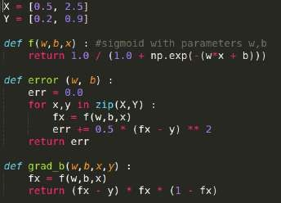
35/62
CS7015 (Deep Learning) : Lecture 3

Slide 162
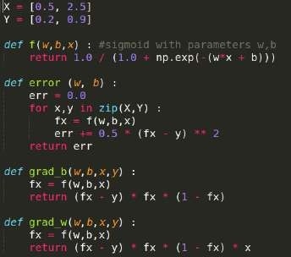
35/62
CS7015 (Deep Learning) : Lecture 3

Slide 163
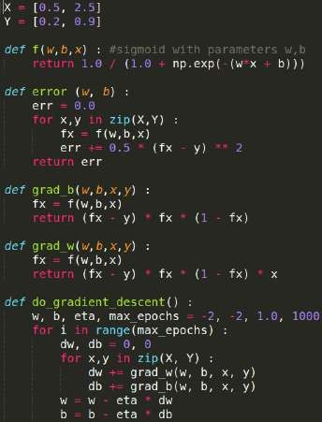
35/62
CS7015 (Deep Learning) : Lecture 3

Slide 164
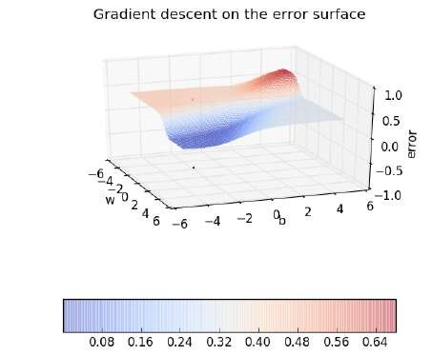
36/62
CS7015 (Deep Learning) : Lecture 3

Slide 165

36/62
CS7015 (Deep Learning) : Lecture 3

Slide 166

36/62
CS7015 (Deep Learning) : Lecture 3

Slide 167

36/62
CS7015 (Deep Learning) : Lecture 3

Slide 168

36/62
CS7015 (Deep Learning) : Lecture 3

Slide 169

36/62
CS7015 (Deep Learning) : Lecture 3

Slide 170

36/62
CS7015 (Deep Learning) : Lecture 3

Slide 171

36/62
CS7015 (Deep Learning) : Lecture 3

Slide 172

36/62
CS7015 (Deep Learning) : Lecture 3

Slide 173

36/62
CS7015 (Deep Learning) : Lecture 3

Slide 174

36/62
CS7015 (Deep Learning) : Lecture 3

Slide 175

36/62
CS7015 (Deep Learning) : Lecture 3

Slide 176

36/62
CS7015 (Deep Learning) : Lecture 3

Slide 177

36/62
CS7015 (Deep Learning) : Lecture 3

Slide 178

36/62
CS7015 (Deep Learning) : Lecture 3

Slide 179

36/62
CS7015 (Deep Learning) : Lecture 3

Slide 180

36/62
CS7015 (Deep Learning) : Lecture 3

Slide 181

36/62
CS7015 (Deep Learning) : Lecture 3

Slide 182

36/62
CS7015 (Deep Learning) : Lecture 3

Slide 183

36/62
CS7015 (Deep Learning) : Lecture 3

Slide 184

36/62
CS7015 (Deep Learning) : Lecture 3

Slide 185

36/62
CS7015 (Deep Learning) : Lecture 3

Slide 186

36/62
CS7015 (Deep Learning) : Lecture 3

Slide 187

36/62
CS7015 (Deep Learning) : Lecture 3

Slide 188

36/62
CS7015 (Deep Learning) : Lecture 3

Slide 189

36/62
CS7015 (Deep Learning) : Lecture 3

Slide 190

36/62
CS7015 (Deep Learning) : Lecture 3

Slide 191

36/62
CS7015 (Deep Learning) : Lecture 3

Slide 192

36/62
CS7015 (Deep Learning) : Lecture 3

Slide 193

36/62
CS7015 (Deep Learning) : Lecture 3

Slide 194

36/62
CS7015 (Deep Learning) : Lecture 3

Slide 195
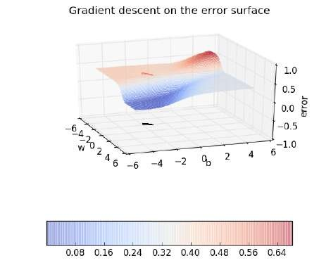
36/62
CS7015 (Deep Learning) : Lecture 3

Slide 196

36/62
CS7015 (Deep Learning) : Lecture 3

Slide 197

36/62
CS7015 (Deep Learning) : Lecture 3

Slide 198

36/62
CS7015 (Deep Learning) : Lecture 3

Slide 199

36/62
CS7015 (Deep Learning) : Lecture 3

Slide 200

36/62
CS7015 (Deep Learning) : Lecture 3

Slide 201

36/62
CS7015 (Deep Learning) : Lecture 3

Slide 202
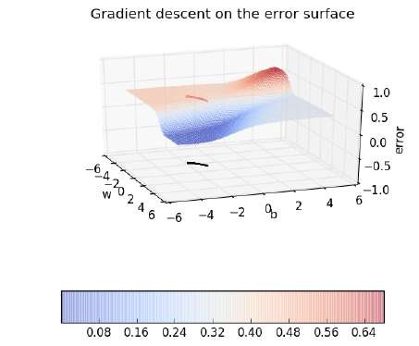
36/62
CS7015 (Deep Learning) : Lecture 3

Slide 203

36/62
CS7015 (Deep Learning) : Lecture 3

Slide 204

36/62
CS7015 (Deep Learning) : Lecture 3

Slide 205

36/62
CS7015 (Deep Learning) : Lecture 3

Slide 206

36/62
CS7015 (Deep Learning) : Lecture 3

Slide 207

36/62
CS7015 (Deep Learning) : Lecture 3

Slide 208

36/62
CS7015 (Deep Learning) : Lecture 3

Slide 209

36/62
CS7015 (Deep Learning) : Lecture 3

Slide 210

36/62
CS7015 (Deep Learning) : Lecture 3

Slide 211

36/62
CS7015 (Deep Learning) : Lecture 3

Slide 212

36/62
CS7015 (Deep Learning) : Lecture 3

Slide 213

36/62
CS7015 (Deep Learning) : Lecture 3

Slide 214

36/62
CS7015 (Deep Learning) : Lecture 3

Slide 215

36/62
CS7015 (Deep Learning) : Lecture 3

Slide 216

36/62
CS7015 (Deep Learning) : Lecture 3

Slide 217

36/62
CS7015 (Deep Learning) : Lecture 3

Slide 218

36/62
CS7015 (Deep Learning) : Lecture 3

Slide 219

36/62
CS7015 (Deep Learning) : Lecture 3

Slide 220

36/62
CS7015 (Deep Learning) : Lecture 3

Slide 221

36/62
CS7015 (Deep Learning) : Lecture 3

Slide 222

36/62
CS7015 (Deep Learning) : Lecture 3

Slide 223

36/62
CS7015 (Deep Learning) : Lecture 3

Slide 224

36/62
CS7015 (Deep Learning) : Lecture 3

Slide 225

36/62
CS7015 (Deep Learning) : Lecture 3

Slide 226

36/62
CS7015 (Deep Learning) : Lecture 3

Slide 227

36/62
CS7015 (Deep Learning) : Lecture 3

Slide 228

36/62
CS7015 (Deep Learning) : Lecture 3

Slide 229

36/62
CS7015 (Deep Learning) : Lecture 3

Slide 230

36/62
CS7015 (Deep Learning) : Lecture 3

Slide 231

36/62
CS7015 (Deep Learning) : Lecture 3

Slide 232

36/62
CS7015 (Deep Learning) : Lecture 3

Slide 233

36/62
CS7015 (Deep Learning) : Lecture 3

Slide 234

36/62
CS7015 (Deep Learning) : Lecture 3

Slide 235

36/62
CS7015 (Deep Learning) : Lecture 3

Slide 236

36/62
CS7015 (Deep Learning) : Lecture 3

Slide 237

36/62
CS7015 (Deep Learning) : Lecture 3

Slide 238

36/62
CS7015 (Deep Learning) : Lecture 3

Slide 239

36/62
CS7015 (Deep Learning) : Lecture 3

Slide 240

36/62
CS7015 (Deep Learning) : Lecture 3

Slide 241

36/62
CS7015 (Deep Learning) : Lecture 3

Slide 242

36/62
CS7015 (Deep Learning) : Lecture 3

Slide 243

36/62
CS7015 (Deep Learning) : Lecture 3

Slide 244

36/62
CS7015 (Deep Learning) : Lecture 3

Slide 245

36/62
CS7015 (Deep Learning) : Lecture 3

Slide 246

36/62
CS7015 (Deep Learning) : Lecture 3

Slide 247

36/62
CS7015 (Deep Learning) : Lecture 3

Slide 248

36/62
CS7015 (Deep Learning) : Lecture 3

Slide 249

36/62
CS7015 (Deep Learning) : Lecture 3

Slide 250

36/62
CS7015 (Deep Learning) : Lecture 3

Slide 251

36/62
CS7015 (Deep Learning) : Lecture 3

Slide 252

36/62
CS7015 (Deep Learning) : Lecture 3

Slide 253

36/62
CS7015 (Deep Learning) : Lecture 3

Slide 254

36/62
CS7015 (Deep Learning) : Lecture 3

Slide 255

36/62
CS7015 (Deep Learning) : Lecture 3

Slide 256

36/62
CS7015 (Deep Learning) : Lecture 3

Slide 257

36/62
CS7015 (Deep Learning) : Lecture 3

Slide 258

36/62
CS7015 (Deep Learning) : Lecture 3

Slide 259

36/62
CS7015 (Deep Learning) : Lecture 3

Slide 260

36/62
CS7015 (Deep Learning) : Lecture 3

Slide 261

36/62
CS7015 (Deep Learning) : Lecture 3

Slide 262

36/62
CS7015 (Deep Learning) : Lecture 3

Slide 263
Later on in the course we will look at gradient descent in much more detail and discuss its variants
37/62
CS7015 (Deep Learning) : Lecture 3

Slide 264
Later on in the course we will look at gradient descent in much more detail and discuss its variants
For the time being it suffices to know that we have an algorithm for learning the parameters of a sigmoid neuron
37/62
CS7015 (Deep Learning) : Lecture 3

Slide 265
Later on in the course we will look at gradient descent in much more detail and discuss its variants
For the time being it suffices to know that we have an algorithm for learning the parameters of a sigmoid neuron
So where do we head from here ?
37/62
CS7015 (Deep Learning) : Lecture 3

Slide 266
Module 3.5: Representation Power of a Multilayer Network of Sigmoid Neurons
38/62
CS7015 (Deep Learning) : Lecture 3

Slide 267
Representation power of a mul- tilayer network of sigmoid neurons
Representation power of a mul- tilayer network of perceptrons
39/62
CS7015 (Deep Learning) : Lecture 3

Slide 268
Representation power of a mul- tilayer network of sigmoid neurons
Representation power of a mul- tilayer network of perceptrons
A multilayer network of perceptronswith a single hidden layer can be used torep- resentanybooleanfunctionprecisely (no errors)
39/62
CS7015 (Deep Learning) : Lecture 3

Slide 269
Representation power of a mul- tilayer network of perceptrons
Representation power of a mul- tilayer network of sigmoid neurons
A multilayer network of perceptronswith a single hidden layer can be used torep- resentanybooleanfunctionprecisely (no errors)
A multilayer network of neuronswith a single hidden layer can be used toapprox- imateanycontinuousfunctionto any desired precision
39/62
CS7015 (Deep Learning) : Lecture 3

Slide 270
Representation power of a mul- tilayer network of perceptrons
Representation power of a mul- tilayer network of sigmoid neurons
A multilayer network of perceptronswith a single hidden layer can be used torep- resentanybooleanfunctionprecisely (no errors)
A multilayer network of neuronswith a single hidden layer can be used toapprox- imateanycontinuousfunctionto any desired precision
In other words, there is a guarantee that for any function f (x) : R^{n} → R^{m}, we can always find a neural network (with 1 hidden layer containing enough neurons) whose output g(x) satisfies |g(x)− f (x)| < ϵ !!
39/62
CS7015 (Deep Learning) : Lecture 3

Slide 271
Representation power of a mul- tilayer network of perceptrons
Representation power of a mul- tilayer network of sigmoid neurons
A multilayer network of perceptronswith a single hidden layer can be used torep- resentanybooleanfunctionprecisely (no errors)
A multilayer network of neuronswith a single hidden layer can be used toapprox- imateanycontinuousfunctionto any desired precision
In other words, there is a guarantee that for any function f (x) : R^{n} → R^{m}, we can always find a neural network (with 1 hidden layer containing enough neurons) whose output g(x) satisfies |g(x)− f (x)| < ϵ !!
Proof: We will see an illustrative proof of this... [Cybenko, 1989], [Hornik, 1991]
39/62
CS7015 (Deep Learning) : Lecture 3

Slide 272
See this link^{٨} for an excellent illustration of this proof
The discussion in the next few slides is based on the ideas presented at the above link
^{s}http://neuralnetworksanddeeplearning.com/chap4.html
40/62
CS7015 (Deep Learning) : Lecture 3

Slide 273
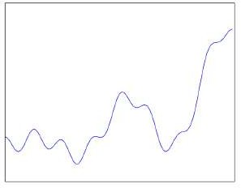
We are interested in knowing whether a network of neurons can be used to represent an arbitrary function (like the one shown in the figure)
41/62
CS7015 (Deep Learning) : Lecture 3

Slide 274
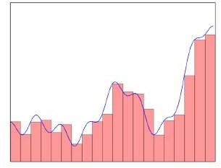
We are interested in knowing whether a network of neurons can be used to represent an arbitrary function (like the one shown in the figure)
We observe that such an arbitrary function can be approximated by sev- eral “tower” functions
41/62
CS7015 (Deep Learning) : Lecture 3

Slide 275
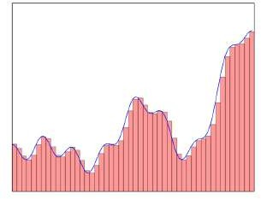
We are interested in knowing whether a network of neurons can be used to represent an arbitrary function (like the one shown in the figure)
We observe that such an arbitrary function can be approximated by sev- eral “tower” functions
More the number of such “tower” functions, better the approximation
41/62
CS7015 (Deep Learning) : Lecture 3

Slide 276
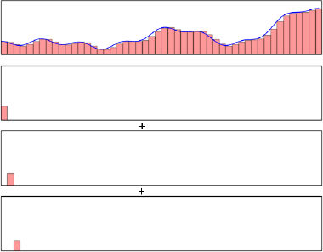
We are interested in knowing whether a network of neurons can be used to represent an arbitrary function (like the one shown in the figure)
We observe that such an arbitrary function can be approximated by sev- eral “tower” functions
More the number of such “tower” functions, better the approximation
To be more precise, we can approxim- ate any arbitrary function by a sum of such “tower” functions
41/62
CS7015 (Deep Learning) : Lecture 3

Slide 277
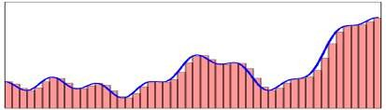
We make a few observations
42/62
CS7015 (Deep Learning) : Lecture 3

Slide 278
We make a few observations
All these “tower” functions are sim- ilar and only differ in their heights and positions on the x-axis
42/62
CS7015 (Deep Learning) : Lecture 3

Slide 279
We make a few observations
All these “tower” functions are sim- ilar and only differ in their heights and positions on the x-axis
Suppose there is a black box which takes the original input (x) and con- structs these tower functions
Tower Tower .
maker maker
. .
. . .
x
Tower Tower maker maker
42/62
CS7015 (Deep Learning) : Lecture 3

Slide 280




We make a few observations
All these “tower” functions are sim- ilar and only differ in their heights and positions on the x-axis
Suppose there is a black box which takes the original input (x) and con- structs these tower functions
. . .
Tower Tower .
maker maker
. .
. . .
x
Tower Tower maker maker
42/62
CS7015 (Deep Learning) : Lecture 3

Slide 281
We make a few observations
All these “tower” functions are sim- ilar and only differ in their heights and positions on the x-axis
Suppose there is a black box which takes the original input (x) and con- structs these tower functions
We can then have a simple network which can just add them up to ap- proximate the function
. . .
Tower Tower .
maker maker
. .
. . .
x
Tower Tower maker maker
42/62
CS7015 (Deep Learning) : Lecture 3

Slide 282
We make a few observations
All these “tower” functions are sim- ilar and only differ in their heights and positions on the x-axis
Suppose there is a black box which takes the original input (x) and con- structs these tower functions
We can then have a simple network which can just add them up to ap- proximate the function
+
. . .
. . .
Tower Tower .
maker maker
. .
. . .
x
Tower Tower maker maker
42/62
CS7015 (Deep Learning) : Lecture 3

Slide 283
We make a few observations
All these “tower” functions are sim- ilar and only differ in their heights and positions on the x-axis
Suppose there is a black box which takes the original input (x) and con- structs these tower functions
We can then have a simple network which can just add them up to ap- proximate the function
Our job now is to figure out what is inside this blackbox
+
. . .
. . .
Tower Tower .
maker maker
. .
. . .
x
Tower Tower maker maker
42/62
CS7015 (Deep Learning) : Lecture 3

Slide 284
We will figure this out over the next few slides ...
43/62
CS7015 (Deep Learning) : Lecture 3

Slide 285
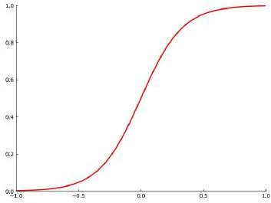
If we take the logistic function and set w to a very high value we will recover the step function
44/62
CS7015 (Deep Learning) : Lecture 3

Slide 286
If we take the logistic function and set w to a very high value we will recover the step function
Let us see what happens as we change the value of w
44/62
CS7015 (Deep Learning) : Lecture 3

Slide 287
If we take the logistic function and set w to a very high value we will recover the step function
Let us see what happens as we change the value of w
σ(x) = ¹ w = 0, b = 0
_{1+e}−(wx+b)
44/62
CS7015 (Deep Learning) : Lecture 3

Slide 288
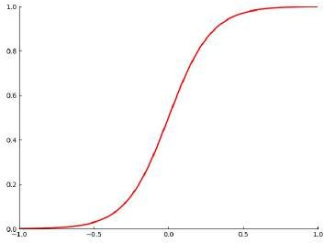
If we take the logistic function and set w to a very high value we will recover the step function
Let us see what happens as we change the value of w
σ(x) = ¹ w = 1, b = 0
_{1+e}−(wx+b)
44/62
CS7015 (Deep Learning) : Lecture 3

Slide 289
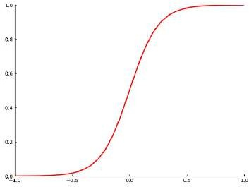
If we take the logistic function and set w to a very high value we will recover the step function
Let us see what happens as we change the value of w
σ(x) = ¹ w = 2, b = 0
_{1+e}−(wx+b)
44/62
CS7015 (Deep Learning) : Lecture 3

Slide 290
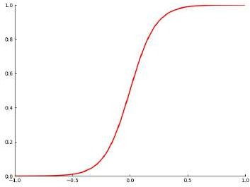
If we take the logistic function and set w to a very high value we will recover the step function
Let us see what happens as we change the value of w
σ(x) = ¹ w = 3, b = 0
_{1+e}−(wx+b)
44/62
CS7015 (Deep Learning) : Lecture 3

Slide 291
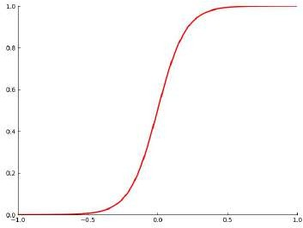
If we take the logistic function and set w to a very high value we will recover the step function
Let us see what happens as we change the value of w
σ(x) = ¹ w = 4, b = 0
_{1+e}−(wx+b)
44/62
CS7015 (Deep Learning) : Lecture 3

Slide 292
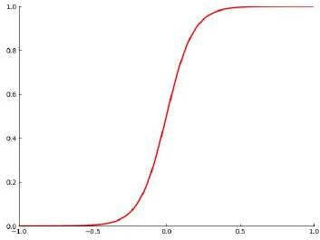
If we take the logistic function and set w to a very high value we will recover the step function
Let us see what happens as we change the value of w
σ(x) = ¹ w = 5, b = 0
_{1+e}−(wx+b)
44/62
CS7015 (Deep Learning) : Lecture 3

Slide 293
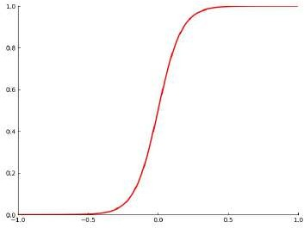
If we take the logistic function and set w to a very high value we will recover the step function
Let us see what happens as we change the value of w
σ(x) = ¹ w = 6, b = 0
_{1+e}−(wx+b)
44/62
CS7015 (Deep Learning) : Lecture 3

Slide 294
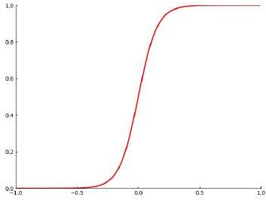
If we take the logistic function and set w to a very high value we will recover the step function
Let us see what happens as we change the value of w
σ(x) = ¹ w = 7, b = 0
_{1+e}−(wx+b)
44/62
CS7015 (Deep Learning) : Lecture 3

Slide 295
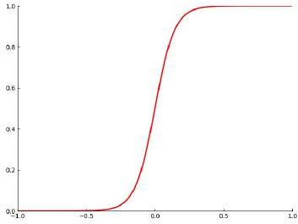
If we take the logistic function and set w to a very high value we will recover the step function
Let us see what happens as we change the value of w
σ(x) = ¹ w = 8, b = 0
_{1+e}−(wx+b)
44/62
CS7015 (Deep Learning) : Lecture 3

Slide 296
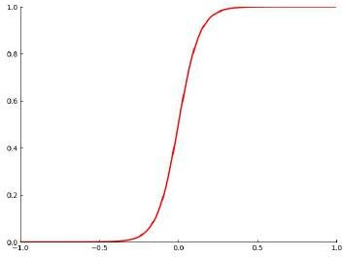
If we take the logistic function and set w to a very high value we will recover the step function
Let us see what happens as we change the value of w
σ(x) = ¹ w = 9, b = 0
_{1+e}−(wx+b)
44/62
CS7015 (Deep Learning) : Lecture 3

Slide 297

If we take the logistic function and set w to a very high value we will recover the step function
Let us see what happens as we change the value of w
σ(x) = ¹ w = 10, b = 0
_{1+e}−(wx+b)
44/62
CS7015 (Deep Learning) : Lecture 3

Slide 298
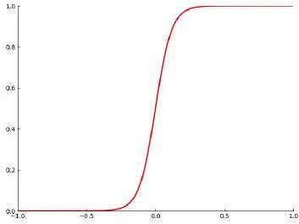
If we take the logistic function and set w to a very high value we will recover the step function
Let us see what happens as we change the value of w
σ(x) = ¹ w = 11, b = 0
_{1+e}−(wx+b)
44/62
CS7015 (Deep Learning) : Lecture 3

Slide 299
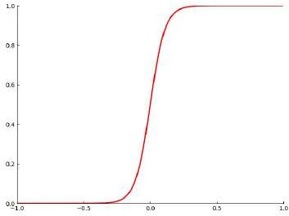
If we take the logistic function and set w to a very high value we will recover the step function
Let us see what happens as we change the value of w
σ(x) = ¹ w = 12, b = 0
_{1+e}−(wx+b)
44/62
CS7015 (Deep Learning) : Lecture 3

Slide 300
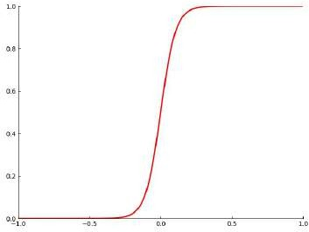
If we take the logistic function and set w to a very high value we will recover the step function
Let us see what happens as we change the value of w
σ(x) = ¹ w = 13, b = 0
_{1+e}−(wx+b)
44/62
CS7015 (Deep Learning) : Lecture 3

Slide 301
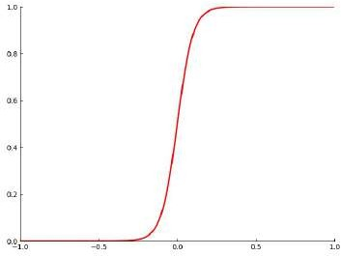
If we take the logistic function and set w to a very high value we will recover the step function
Let us see what happens as we change the value of w
σ(x) = ¹ w = 14, b = 0
_{1+e}−(wx+b)
44/62
CS7015 (Deep Learning) : Lecture 3

Slide 302
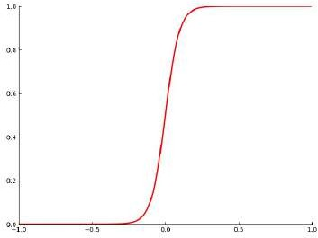
If we take the logistic function and set w to a very high value we will recover the step function
Let us see what happens as we change the value of w
σ(x) = ¹ w = 15, b = 0
_{1+e}−(wx+b)
44/62
CS7015 (Deep Learning) : Lecture 3

Slide 303
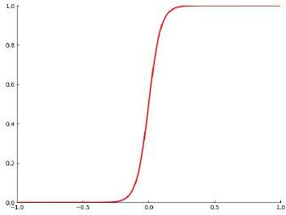
If we take the logistic function and set w to a very high value we will recover the step function
Let us see what happens as we change the value of w
σ(x) = ¹ w = 16, b = 0
_{1+e}−(wx+b)
44/62
CS7015 (Deep Learning) : Lecture 3

Slide 304
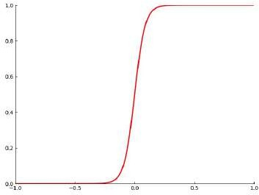
If we take the logistic function and set w to a very high value we will recover the step function
Let us see what happens as we change the value of w
σ(x) = ¹ w = 17, b = 0
_{1+e}−(wx+b)
44/62
CS7015 (Deep Learning) : Lecture 3

Slide 305
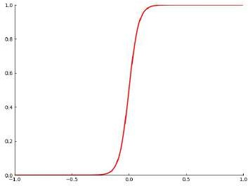
If we take the logistic function and set w to a very high value we will recover the step function
Let us see what happens as we change the value of w
σ(x) = ¹ w = 18, b = 0
_{1+e}−(wx+b)
44/62
CS7015 (Deep Learning) : Lecture 3

Slide 306
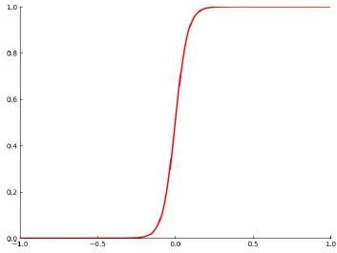
If we take the logistic function and set w to a very high value we will recover the step function
Let us see what happens as we change the value of w
σ(x) = ¹ w = 19, b = 0
_{1+e}−(wx+b)
44/62
CS7015 (Deep Learning) : Lecture 3

Slide 307
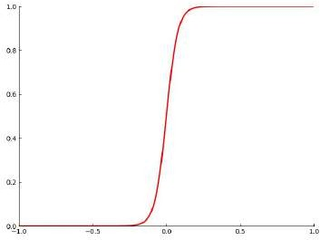
If we take the logistic function and set w to a very high value we will recover the step function
Let us see what happens as we change the value of w
σ(x) = ¹ w = 20, b = 0
_{1+e}−(wx+b)
44/62
CS7015 (Deep Learning) : Lecture 3

Slide 308
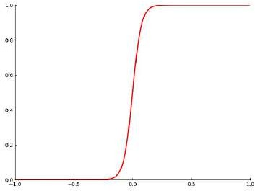
If we take the logistic function and set w to a very high value we will recover the step function
Let us see what happens as we change the value of w
σ(x) = ¹ w = 21, b = 0
_{1+e}−(wx+b)
44/62
CS7015 (Deep Learning) : Lecture 3

Slide 309
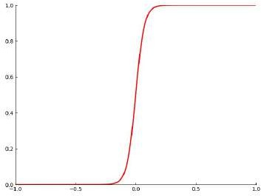
If we take the logistic function and set w to a very high value we will recover the step function
Let us see what happens as we change the value of w
σ(x) = ¹ w = 22, b = 0
_{1+e}−(wx+b)
44/62
CS7015 (Deep Learning) : Lecture 3

Slide 310

If we take the logistic function and set w to a very high value we will recover the step function
Let us see what happens as we change the value of w
σ(x) = ¹ w = 23, b = 0
_{1+e}−(wx+b)
44/62
CS7015 (Deep Learning) : Lecture 3

Slide 311

If we take the logistic function and set w to a very high value we will recover the step function
Let us see what happens as we change the value of w
σ(x) = ¹ w = 24, b = 0
_{1+e}−(wx+b)
44/62
CS7015 (Deep Learning) : Lecture 3

Slide 312

If we take the logistic function and set w to a very high value we will recover the step function
Let us see what happens as we change the value of w
σ(x) = ¹ w = 25, b = 0
_{1+e}−(wx+b)
44/62
CS7015 (Deep Learning) : Lecture 3

Slide 313

If we take the logistic function and set w to a very high value we will recover the step function
Let us see what happens as we change the value of w
σ(x) = ¹ w = 26, b = 0
_{1+e}−(wx+b)
44/62
CS7015 (Deep Learning) : Lecture 3

Slide 314

If we take the logistic function and set w to a very high value we will recover the step function
Let us see what happens as we change the value of w
σ(x) = ¹ w = 27, b = 0
_{1+e}−(wx+b)
44/62
CS7015 (Deep Learning) : Lecture 3

Slide 315

If we take the logistic function and set w to a very high value we will recover the step function
Let us see what happens as we change the value of w
σ(x) = ¹ w = 28, b = 0
_{1+e}−(wx+b)
44/62
CS7015 (Deep Learning) : Lecture 3

Slide 316

If we take the logistic function and set w to a very high value we will recover the step function
Let us see what happens as we change the value of w
σ(x) = ¹ w = 29, b = 0
_{1+e}−(wx+b)
44/62
CS7015 (Deep Learning) : Lecture 3

Slide 317

If we take the logistic function and set w to a very high value we will recover the step function
Let us see what happens as we change the value of w
σ(x) = ¹ w = 30, b = 0
_{1+e}−(wx+b)
44/62
CS7015 (Deep Learning) : Lecture 3

Slide 318

If we take the logistic function and set w to a very high value we will recover the step function
Let us see what happens as we change the value of w
σ(x) = ¹ w = 31, b = 0
_{1+e}−(wx+b)
44/62
CS7015 (Deep Learning) : Lecture 3

Slide 319

If we take the logistic function and set w to a very high value we will recover the step function
Let us see what happens as we change the value of w
σ(x) = ¹ w = 32, b = 0
_{1+e}−(wx+b)
44/62
CS7015 (Deep Learning) : Lecture 3

Slide 320

If we take the logistic function and set w to a very high value we will recover the step function
Let us see what happens as we change the value of w
σ(x) = ¹ w = 33, b = 0
_{1+e}−(wx+b)
44/62
CS7015 (Deep Learning) : Lecture 3

Slide 321

If we take the logistic function and set w to a very high value we will recover the step function
Let us see what happens as we change the value of w
σ(x) = ¹ w = 34, b = 0
_{1+e}−(wx+b)
44/62
CS7015 (Deep Learning) : Lecture 3

Slide 322

If we take the logistic function and set w to a very high value we will recover the step function
Let us see what happens as we change the value of w
σ(x) = ¹ w = 35, b = 0
_{1+e}−(wx+b)
44/62
CS7015 (Deep Learning) : Lecture 3

Slide 323

If we take the logistic function and set w to a very high value we will recover the step function
Let us see what happens as we change the value of w
σ(x) = ¹ w = 36, b = 0
_{1+e}−(wx+b)
44/62
CS7015 (Deep Learning) : Lecture 3

Slide 324

If we take the logistic function and set w to a very high value we will recover the step function
Let us see what happens as we change the value of w
σ(x) = ¹ w = 37, b = 0
_{1+e}−(wx+b)
44/62
CS7015 (Deep Learning) : Lecture 3

Slide 325

If we take the logistic function and set w to a very high value we will recover the step function
Let us see what happens as we change the value of w
σ(x) = ¹ w = 38, b = 0
_{1+e}−(wx+b)
44/62
CS7015 (Deep Learning) : Lecture 3

Slide 326

If we take the logistic function and set w to a very high value we will recover the step function
Let us see what happens as we change the value of w
σ(x) = ¹ w = 39, b = 0
_{1+e}−(wx+b)
44/62
CS7015 (Deep Learning) : Lecture 3

Slide 327

If we take the logistic function and set w to a very high value we will recover the step function
Let us see what happens as we change the value of w
σ(x) = ¹ w = 40, b = 0
_{1+e}−(wx+b)
44/62
CS7015 (Deep Learning) : Lecture 3

Slide 328

If we take the logistic function and set w to a very high value we will recover the step function
Let us see what happens as we change the value of w
σ(x) = ¹ w = 41, b = 0
_{1+e}−(wx+b)
44/62
CS7015 (Deep Learning) : Lecture 3

Slide 329

If we take the logistic function and set w to a very high value we will recover the step function
Let us see what happens as we change the value of w
Further we can adjust the value of b to control the position on the x-axis at which the function transitions from 0 to 1
σ(x) = ¹ w = 50, b = 1
_{1+e}−(wx+b)
44/62
CS7015 (Deep Learning) : Lecture 3

Slide 330

If we take the logistic function and set w to a very high value we will recover the step function
Let us see what happens as we change the value of w
Further we can adjust the value of b to control the position on the x-axis at which the function transitions from 0 to 1
σ(x) = ¹ w = 50, b = 2
_{1+e}−(wx+b)
44/62
CS7015 (Deep Learning) : Lecture 3

Slide 331

If we take the logistic function and set w to a very high value we will recover the step function
Let us see what happens as we change the value of w
Further we can adjust the value of b to control the position on the x-axis at which the function transitions from 0 to 1
σ(x) = ¹ w = 50, b = 3
_{1+e}−(wx+b)
44/62
CS7015 (Deep Learning) : Lecture 3

Slide 332

If we take the logistic function and set w to a very high value we will recover the step function
Let us see what happens as we change the value of w
Further we can adjust the value of b to control the position on the x-axis at which the function transitions from 0 to 1
σ(x) = ¹ w = 50, b = 4
_{1+e}−(wx+b)
44/62
CS7015 (Deep Learning) : Lecture 3

Slide 333

If we take the logistic function and set w to a very high value we will recover the step function
Let us see what happens as we change the value of w
Further we can adjust the value of b to control the position on the x-axis at which the function transitions from 0 to 1
σ(x) = ¹ w = 50, b = 5
_{1+e}−(wx+b)
44/62
CS7015 (Deep Learning) : Lecture 3

Slide 334

If we take the logistic function and set w to a very high value we will recover the step function
Let us see what happens as we change the value of w
Further we can adjust the value of b to control the position on the x-axis at which the function transitions from 0 to 1
σ(x) = ¹ w = 50, b = 6
_{1+e}−(wx+b)
44/62
CS7015 (Deep Learning) : Lecture 3

Slide 335

If we take the logistic function and set w to a very high value we will recover the step function
Let us see what happens as we change the value of w
Further we can adjust the value of b to control the position on the x-axis at which the function transitions from 0 to 1
σ(x) = ¹ w = 50, b = 7
_{1+e}−(wx+b)
44/62
CS7015 (Deep Learning) : Lecture 3

Slide 336

If we take the logistic function and set w to a very high value we will recover the step function
Let us see what happens as we change the value of w
Further we can adjust the value of b to control the position on the x-axis at which the function transitions from 0 to 1
σ(x) = ¹ w = 50, b = 8
_{1+e}−(wx+b)
44/62
CS7015 (Deep Learning) : Lecture 3

Slide 337

If we take the logistic function and set w to a very high value we will recover the step function
Let us see what happens as we change the value of w
Further we can adjust the value of b to control the position on the x-axis at which the function transitions from 0 to 1
σ(x) = ¹ w = 50, b = 9
_{1+e}−(wx+b)
44/62
CS7015 (Deep Learning) : Lecture 3

Slide 338

If we take the logistic function and set w to a very high value we will recover the step function
Let us see what happens as we change the value of w
Further we can adjust the value of b to control the position on the x-axis at which the function transitions from 0 to 1
σ(x) = ¹ w = 50, b = 10
_{1+e}−(wx+b)
44/62
CS7015 (Deep Learning) : Lecture 3

Slide 339

If we take the logistic function and set w to a very high value we will recover the step function
Let us see what happens as we change the value of w
Further we can adjust the value of b to control the position on the x-axis at which the function transitions from 0 to 1
σ(x) = ¹ w = 50, b = 11
_{1+e}−(wx+b)
44/62
CS7015 (Deep Learning) : Lecture 3

Slide 340

If we take the logistic function and set w to a very high value we will recover the step function
Let us see what happens as we change the value of w
Further we can adjust the value of b to control the position on the x-axis at which the function transitions from 0 to 1
σ(x) = ¹ w = 50, b = 12
_{1+e}−(wx+b)
44/62
CS7015 (Deep Learning) : Lecture 3

Slide 341

If we take the logistic function and set w to a very high value we will recover the step function
Let us see what happens as we change the value of w
Further we can adjust the value of b to control the position on the x-axis at which the function transitions from 0 to 1
σ(x) = ¹ w = 50, b = 13
_{1+e}−(wx+b)
44/62
CS7015 (Deep Learning) : Lecture 3

Slide 342

If we take the logistic function and set w to a very high value we will recover the step function
Let us see what happens as we change the value of w
Further we can adjust the value of b to control the position on the x-axis at which the function transitions from 0 to 1
σ(x) = ¹ w = 50, b = 14
_{1+e}−(wx+b)
44/62
CS7015 (Deep Learning) : Lecture 3

Slide 343

If we take the logistic function and set w to a very high value we will recover the step function
Let us see what happens as we change the value of w
Further we can adjust the value of b to control the position on the x-axis at which the function transitions from 0 to 1
σ(x) = ¹ w = 50, b = 15
_{1+e}−(wx+b)
44/62
CS7015 (Deep Learning) : Lecture 3

Slide 344

If we take the logistic function and set w to a very high value we will recover the step function
Let us see what happens as we change the value of w
Further we can adjust the value of b to control the position on the x-axis at which the function transitions from 0 to 1
σ(x) = ¹ w = 50, b = 16
_{1+e}−(wx+b)
44/62
CS7015 (Deep Learning) : Lecture 3

Slide 345

If we take the logistic function and set w to a very high value we will recover the step function
Let us see what happens as we change the value of w
Further we can adjust the value of b to control the position on the x-axis at which the function transitions from 0 to 1
σ(x) = ¹ w = 50, b = 17
_{1+e}−(wx+b)
44/62
CS7015 (Deep Learning) : Lecture 3

Slide 346

If we take the logistic function and set w to a very high value we will recover the step function
Let us see what happens as we change the value of w
Further we can adjust the value of b to control the position on the x-axis at which the function transitions from 0 to 1
σ(x) = ¹ w = 50, b = 18
_{1+e}−(wx+b)
44/62
CS7015 (Deep Learning) : Lecture 3

Slide 347

If we take the logistic function and set w to a very high value we will recover the step function
Let us see what happens as we change the value of w
Further we can adjust the value of b to control the position on the x-axis at which the function transitions from 0 to 1
σ(x) = ¹ w = 50, b = 19
_{1+e}−(wx+b)
44/62
CS7015 (Deep Learning) : Lecture 3

Slide 348

If we take the logistic function and set w to a very high value we will recover the step function
Let us see what happens as we change the value of w
Further we can adjust the value of b to control the position on the x-axis at which the function transitions from 0 to 1
σ(x) = ¹ w = 50, b = 20
_{1+e}−(wx+b)
44/62
CS7015 (Deep Learning) : Lecture 3

Slide 349

If we take the logistic function and set w to a very high value we will recover the step function
Let us see what happens as we change the value of w
Further we can adjust the value of b to control the position on the x-axis at which the function transitions from 0 to 1
σ(x) = ¹ w = 50, b = 21
_{1+e}−(wx+b)
44/62
CS7015 (Deep Learning) : Lecture 3

Slide 350

If we take the logistic function and set w to a very high value we will recover the step function
Let us see what happens as we change the value of w
Further we can adjust the value of b to control the position on the x-axis at which the function transitions from 0 to 1
σ(x) = ¹ w = 50, b = 22
_{1+e}−(wx+b)
44/62
CS7015 (Deep Learning) : Lecture 3

Slide 351

If we take the logistic function and set w to a very high value we will recover the step function
Let us see what happens as we change the value of w
Further we can adjust the value of b to control the position on the x-axis at which the function transitions from 0 to 1
σ(x) = ¹ w = 50, b = 23
_{1+e}−(wx+b)
44/62
CS7015 (Deep Learning) : Lecture 3

Slide 352

If we take the logistic function and set w to a very high value we will recover the step function
Let us see what happens as we change the value of w
Further we can adjust the value of b to control the position on the x-axis at which the function transitions from 0 to 1
σ(x) = ¹ w = 50, b = 24
_{1+e}−(wx+b)
44/62
CS7015 (Deep Learning) : Lecture 3

Slide 353

If we take the logistic function and set w to a very high value we will recover the step function
Let us see what happens as we change the value of w
Further we can adjust the value of b to control the position on the x-axis at which the function transitions from 0 to 1
σ(x) = ¹ w = 50, b = 25
_{1+e}−(wx+b)
44/62
CS7015 (Deep Learning) : Lecture 3

Slide 354

If we take the logistic function and set w to a very high value we will recover the step function
Let us see what happens as we change the value of w
Further we can adjust the value of b to control the position on the x-axis at which the function transitions from 0 to 1
σ(x) = ¹ w = 50, b = 26
_{1+e}−(wx+b)
44/62
CS7015 (Deep Learning) : Lecture 3

Slide 355

If we take the logistic function and set w to a very high value we will recover the step function
Let us see what happens as we change the value of w
Further we can adjust the value of b to control the position on the x-axis at which the function transitions from 0 to 1
σ(x) = ¹ w = 50, b = 27
_{1+e}−(wx+b)
44/62
CS7015 (Deep Learning) : Lecture 3

Slide 356

If we take the logistic function and set w to a very high value we will recover the step function
Let us see what happens as we change the value of w
Further we can adjust the value of b to control the position on the x-axis at which the function transitions from 0 to 1
σ(x) = ¹ w = 50, b = 28
_{1+e}−(wx+b)
44/62
CS7015 (Deep Learning) : Lecture 3

Slide 357

If we take the logistic function and set w to a very high value we will recover the step function
Let us see what happens as we change the value of w
Further we can adjust the value of b to control the position on the x-axis at which the function transitions from 0 to 1
σ(x) = ¹ w = 50, b = 29
_{1+e}−(wx+b)
44/62
CS7015 (Deep Learning) : Lecture 3

Slide 358

If we take the logistic function and set w to a very high value we will recover the step function
Let us see what happens as we change the value of w
Further we can adjust the value of b to control the position on the x-axis at which the function transitions from 0 to 1
σ(x) = ¹ w = 50, b = 30
_{1+e}−(wx+b)
44/62
CS7015 (Deep Learning) : Lecture 3

Slide 359

If we take the logistic function and set w to a very high value we will recover the step function
Let us see what happens as we change the value of w
Further we can adjust the value of b to control the position on the x-axis at which the function transitions from 0 to 1
σ(x) = ¹ w = 50, b = 31
_{1+e}−(wx+b)
44/62
CS7015 (Deep Learning) : Lecture 3

Slide 360

If we take the logistic function and set w to a very high value we will recover the step function
Let us see what happens as we change the value of w
Further we can adjust the value of b to control the position on the x-axis at which the function transitions from 0 to 1
σ(x) = ¹ w = 50, b = 32
_{1+e}−(wx+b)
44/62
CS7015 (Deep Learning) : Lecture 3

Slide 361

If we take the logistic function and set w to a very high value we will recover the step function
Let us see what happens as we change the value of w
Further we can adjust the value of b to control the position on the x-axis at which the function transitions from 0 to 1
σ(x) = ¹ w = 50, b = 33
_{1+e}−(wx+b)
44/62
CS7015 (Deep Learning) : Lecture 3

Slide 362

If we take the logistic function and set w to a very high value we will recover the step function
Let us see what happens as we change the value of w
Further we can adjust the value of b to control the position on the x-axis at which the function transitions from 0 to 1
σ(x) = ¹ w = 50, b = 34
_{1+e}−(wx+b)
44/62
CS7015 (Deep Learning) : Lecture 3

Slide 363

If we take the logistic function and set w to a very high value we will recover the step function
Let us see what happens as we change the value of w
Further we can adjust the value of b to control the position on the x-axis at which the function transitions from 0 to 1
σ(x) = ¹ w = 50, b = 35
_{1+e}−(wx+b)
44/62
CS7015 (Deep Learning) : Lecture 3

Slide 364

Now let us see what we get by taking two such sigmoid functions (with dif- ferent b^{j}s) and subtracting one from the other
45/62
CS7015 (Deep Learning) : Lecture 3

Slide 365
Now let us see what we get by taking two such sigmoid functions (with dif- ferent b^{j}s) and subtracting one from the other
45/62
CS7015 (Deep Learning) : Lecture 3

Slide 366

Now let us see what we get by taking two such sigmoid functions (with dif- ferent b^{j}s) and subtracting one from the other
45/62
CS7015 (Deep Learning) : Lecture 3

Slide 367
Now let us see what we get by taking two such sigmoid functions (with dif- ferent b^{j}s) and subtracting one from the other
Voila! We have our tower function !!
45/62
CS7015 (Deep Learning) : Lecture 3

Slide 368
Can we come up with a neural network to represent this operation of subtracting one sigmoid function from another ?
46/62
CS7015 (Deep Learning) : Lecture 3

Slide 369




47/62
CS7015 (Deep Learning) : Lecture 3

Slide 370
What if we have more than one input?
48/62
CS7015 (Deep Learning) : Lecture 3

Slide 371
What if we have more than one input?
Suppose we are trying to take a decision about whether we will find oil at a particular location on the ocean bed(Yes/No)
48/62
CS7015 (Deep Learning) : Lecture 3

Slide 372
What if we have more than one input?
Suppose we are trying to take a decision about whether we will find oil at a particular location on the ocean bed(Yes/No)
Further, suppose we base our decision on two factors: Salinity (x₁) and Pressure (x₂)
48/62
CS7015 (Deep Learning) : Lecture 3

Slide 373

What if we have more than one input?
Suppose we are trying to take a decision about whether we will find oil at a particular location on the ocean bed(Yes/No)
Further, suppose we base our decision on two factors: Salinity (x₁) and Pressure (x₂)
We are given some data and it seems that y(oil|no-oil) is a complex function of x₁ and x₂
48/62
CS7015 (Deep Learning) : Lecture 3

Slide 374
What if we have more than one input?
Suppose we are trying to take a decision about whether we will find oil at a particular location on the ocean bed(Yes/No)
Further, suppose we base our decision on two factors: Salinity (x₁) and Pressure (x₂)
We are given some data and it seems that y(oil|no-oil) is a complex function of x₁ and x₂
We want a neural network to approximate this function
48/62
CS7015 (Deep Learning) : Lecture 3

Slide 375

This is what a 2-dimensional sigmoid looks like
1
y =
_{1 + e}−(w1x1+w2x2+b)
49/62
CS7015 (Deep Learning) : Lecture 3

Slide 376
This is what a 2-dimensional sigmoid looks like
We need to figure out how to get a tower in this case
1
y =
_{1 + e}−(w1x1+w2x2+b)
49/62
CS7015 (Deep Learning) : Lecture 3

Slide 377
This is what a 2-dimensional sigmoid looks like
We need to figure out how to get a tower in this case
First, let us set w₂ to 0 and see if we can get a two dimensional step func- tion
1
y =
_{1 + e}−(w1x1+w2x2+b)
49/62
CS7015 (Deep Learning) : Lecture 3

Slide 378

This is what a 2-dimensional sigmoid looks like
We need to figure out how to get a tower in this case
First, let us set w₂ to 0 and see if we can get a two dimensional step func- tion
1
y =
_{1 + e}−(w1x1+w2x2+b)
49/62
CS7015 (Deep Learning) : Lecture 3

Slide 379

This is what a 2-dimensional sigmoid looks like
We need to figure out how to get a tower in this case
First, let us set w₂ to 0 and see if we can get a two dimensional step func- tion
1
y =
_{1 + e}−(w1x1+w2x2+b)
49/62
CS7015 (Deep Learning) : Lecture 3

Slide 380

This is what a 2-dimensional sigmoid looks like
We need to figure out how to get a tower in this case
First, let us set w₂ to 0 and see if we can get a two dimensional step func- tion
1
y =
_{1 + e}−(w1x1+w2x2+b)
49/62
CS7015 (Deep Learning) : Lecture 3

Slide 381

This is what a 2-dimensional sigmoid looks like
We need to figure out how to get a tower in this case
First, let us set w₂ to 0 and see if we can get a two dimensional step func- tion
1
y =
_{1 + e}−(w1x1+w2x2+b)
49/62
CS7015 (Deep Learning) : Lecture 3

Slide 382

This is what a 2-dimensional sigmoid looks like
We need to figure out how to get a tower in this case
First, let us set w₂ to 0 and see if we can get a two dimensional step func- tion
1
y =
_{1 + e}−(w1x1+w2x2+b)
49/62
CS7015 (Deep Learning) : Lecture 3

Slide 383

This is what a 2-dimensional sigmoid looks like
We need to figure out how to get a tower in this case
First, let us set w₂ to 0 and see if we can get a two dimensional step func- tion
1
y =
_{1 + e}−(w1x1+w2x2+b)
49/62
CS7015 (Deep Learning) : Lecture 3

Slide 384

This is what a 2-dimensional sigmoid looks like
We need to figure out how to get a tower in this case
First, let us set w₂ to 0 and see if we can get a two dimensional step func- tion
1
y =
_{1 + e}−(w1x1+w2x2+b)
49/62
CS7015 (Deep Learning) : Lecture 3

Slide 385

This is what a 2-dimensional sigmoid looks like
We need to figure out how to get a tower in this case
First, let us set w₂ to 0 and see if we can get a two dimensional step func- tion
1
y =
_{1 + e}−(w1x1+w2x2+b)
49/62
CS7015 (Deep Learning) : Lecture 3

Slide 386

This is what a 2-dimensional sigmoid looks like
We need to figure out how to get a tower in this case
First, let us set w₂ to 0 and see if we can get a two dimensional step func- tion
1
y =
_{1 + e}−(w1x1+w2x2+b)
49/62
CS7015 (Deep Learning) : Lecture 3

Slide 387

This is what a 2-dimensional sigmoid looks like
We need to figure out how to get a tower in this case
First, let us set w₂ to 0 and see if we can get a two dimensional step func- tion
1
y =
_{1 + e}−(w1x1+w2x2+b)
49/62
CS7015 (Deep Learning) : Lecture 3

Slide 388

This is what a 2-dimensional sigmoid looks like
We need to figure out how to get a tower in this case
First, let us set w₂ to 0 and see if we can get a two dimensional step func- tion
1
y =
_{1 + e}−(w1x1+w2x2+b)
49/62
CS7015 (Deep Learning) : Lecture 3

Slide 389

This is what a 2-dimensional sigmoid looks like
We need to figure out how to get a tower in this case
First, let us set w₂ to 0 and see if we can get a two dimensional step func- tion
1
y =
_{1 + e}−(w1x1+w2x2+b)
49/62
CS7015 (Deep Learning) : Lecture 3

Slide 390

This is what a 2-dimensional sigmoid looks like
We need to figure out how to get a tower in this case
First, let us set w₂ to 0 and see if we can get a two dimensional step func- tion
1
y =
_{1 + e}−(w1x1+w2x2+b)
49/62
CS7015 (Deep Learning) : Lecture 3

Slide 391

This is what a 2-dimensional sigmoid looks like
We need to figure out how to get a tower in this case
First, let us set w₂ to 0 and see if we can get a two dimensional step func- tion
1
y =
_{1 + e}−(w1x1+w2x2+b)
49/62
CS7015 (Deep Learning) : Lecture 3

Slide 392

This is what a 2-dimensional sigmoid looks like
We need to figure out how to get a tower in this case
First, let us set w₂ to 0 and see if we can get a two dimensional step func- tion
1
y =
_{1 + e}−(w1x1+w2x2+b)
49/62
CS7015 (Deep Learning) : Lecture 3

Slide 393

This is what a 2-dimensional sigmoid looks like
We need to figure out how to get a tower in this case
First, let us set w₂ to 0 and see if we can get a two dimensional step func- tion
1
y =
_{1 + e}−(w1x1+w2x2+b)
49/62
CS7015 (Deep Learning) : Lecture 3

Slide 394

This is what a 2-dimensional sigmoid looks like
We need to figure out how to get a tower in this case
First, let us set w₂ to 0 and see if we can get a two dimensional step func- tion
1
y =
_{1 + e}−(w1x1+w2x2+b)
49/62
CS7015 (Deep Learning) : Lecture 3

Slide 395

This is what a 2-dimensional sigmoid looks like
We need to figure out how to get a tower in this case
First, let us set w₂ to 0 and see if we can get a two dimensional step func- tion
1
y =
_{1 + e}−(w1x1+w2x2+b)
49/62
CS7015 (Deep Learning) : Lecture 3

Slide 396

This is what a 2-dimensional sigmoid looks like
We need to figure out how to get a tower in this case
First, let us set w₂ to 0 and see if we can get a two dimensional step func- tion
1
y =
_{1 + e}−(w1x1+w2x2+b)
49/62
CS7015 (Deep Learning) : Lecture 3

Slide 397

This is what a 2-dimensional sigmoid looks like
We need to figure out how to get a tower in this case
First, let us set w₂ to 0 and see if we can get a two dimensional step func- tion
1
y =
_{1 + e}−(w1x1+w2x2+b)
49/62
CS7015 (Deep Learning) : Lecture 3

Slide 398

This is what a 2-dimensional sigmoid looks like
We need to figure out how to get a tower in this case
First, let us set w₂ to 0 and see if we can get a two dimensional step func- tion
1
y =
_{1 + e}−(w1x1+w2x2+b)
49/62
CS7015 (Deep Learning) : Lecture 3

Slide 399

This is what a 2-dimensional sigmoid looks like
We need to figure out how to get a tower in this case
First, let us set w₂ to 0 and see if we can get a two dimensional step func- tion
1
y =
_{1 + e}−(w1x1+w2x2+b)
w₁ = 24, w₂ = 0, b = 0
49/62
CS7015 (Deep Learning) : Lecture 3

Slide 400

This is what a 2-dimensional sigmoid looks like
We need to figure out how to get a tower in this case
First, let us set w₂ to 0 and see if we can get a two dimensional step func- tion
What would happen if we change b ?
1
y =
_{1 + e}−(w1x1+w2x2+b)
49/62
CS7015 (Deep Learning) : Lecture 3

Slide 401

This is what a 2-dimensional sigmoid looks like
We need to figure out how to get a tower in this case
First, let us set w₂ to 0 and see if we can get a two dimensional step func- tion
What would happen if we change b ?
1
y =
_{1 + e}−(w1x1+w2x2+b)
w₁ = 25, w₂ = 0, b = 5
50/62
CS7015 (Deep Learning) : Lecture 3

Slide 402

This is what a 2-dimensional sigmoid looks like
We need to figure out how to get a tower in this case
First, let us set w₂ to 0 and see if we can get a two dimensional step func- tion
What would happen if we change b ?
1
y =
_{1 + e}−(w1x1+w2x2+b)
w₁ = 25, w₂ = 0, b = 10
50/62
CS7015 (Deep Learning) : Lecture 3

Slide 403

This is what a 2-dimensional sigmoid looks like
We need to figure out how to get a tower in this case
First, let us set w₂ to 0 and see if we can get a two dimensional step func- tion
What would happen if we change b ?
1
y =
_{1 + e}−(w1x1+w2x2+b)
w₁ = 25, w₂ = 0, b = 15
50/62
CS7015 (Deep Learning) : Lecture 3

Slide 404

This is what a 2-dimensional sigmoid looks like
We need to figure out how to get a tower in this case
First, let us set w₂ to 0 and see if we can get a two dimensional step func- tion
What would happen if we change b ?
1
y =
_{1 + e}−(w1x1+w2x2+b)
w₁ = 25, w₂ = 0, b = 20
50/62
CS7015 (Deep Learning) : Lecture 3

Slide 405

This is what a 2-dimensional sigmoid looks like
We need to figure out how to get a tower in this case
First, let us set w₂ to 0 and see if we can get a two dimensional step func- tion
What would happen if we change b ?
1
y =
_{1 + e}−(w1x1+w2x2+b)
w₁ = 25, w₂ = 0, b = 25
50/62
CS7015 (Deep Learning) : Lecture 3

Slide 406

This is what a 2-dimensional sigmoid looks like
We need to figure out how to get a tower in this case
First, let us set w₂ to 0 and see if we can get a two dimensional step func- tion
What would happen if we change b ?
1
y =
_{1 + e}−(w1x1+w2x2+b)
w₁ = 25, w₂ = 0, b = 30
50/62
CS7015 (Deep Learning) : Lecture 3

Slide 407

This is what a 2-dimensional sigmoid looks like
We need to figure out how to get a tower in this case
First, let us set w₂ to 0 and see if we can get a two dimensional step func- tion
What would happen if we change b ?
1
y =
_{1 + e}−(w1x1+w2x2+b)
w₁ = 25, w₂ = 0, b = 35
50/62
CS7015 (Deep Learning) : Lecture 3

Slide 408

This is what a 2-dimensional sigmoid looks like
We need to figure out how to get a tower in this case
First, let us set w₂ to 0 and see if we can get a two dimensional step func- tion
What would happen if we change b ?
1
y =
_{1 + e}−(w1x1+w2x2+b)
w₁ = 25, w₂ = 0, b = 40
50/62
CS7015 (Deep Learning) : Lecture 3

Slide 409

This is what a 2-dimensional sigmoid looks like
We need to figure out how to get a tower in this case
First, let us set w₂ to 0 and see if we can get a two dimensional step func- tion
What would happen if we change b ?
1
y =
_{1 + e}−(w1x1+w2x2+b)
w₁ = 25, w₂ = 0, b = 45
50/62
CS7015 (Deep Learning) : Lecture 3

Slide 410

What if we take two such step func- tions (with different b values) and subtract one from the other
51/62
CS7015 (Deep Learning) : Lecture 3

Slide 411
What if we take two such step func- tions (with different b values) and subtract one from the other
51/62
CS7015 (Deep Learning) : Lecture 3

Slide 412

What if we take two such step func- tions (with different b values) and subtract one from the other
51/62
CS7015 (Deep Learning) : Lecture 3

Slide 413
What if we take two such step func- tions (with different b values) and subtract one from the other
We still don’t get a tower (or we get a tower which is open from two sides)
51/62
CS7015 (Deep Learning) : Lecture 3

Slide 414

Now let us set w₁ to 0 and adjust w₂ to get a 2-dimensional step function with a different orientation
1
y =
_{1 + e}−(w1x1+w2x2+b)
52/62
CS7015 (Deep Learning) : Lecture 3

Slide 415
Now let us set w₁ to 0 and adjust w₂ to get a 2-dimensional step function with a different orientation
1
y =
_{1 + e}−(w1x1+w2x2+b)
52/62
CS7015 (Deep Learning) : Lecture 3

Slide 416
Now let us set w₁ to 0 and adjust w₂ to get a 2-dimensional step function with a different orientation
1
y =
_{1 + e}−(w1x1+w2x2+b)
52/62
CS7015 (Deep Learning) : Lecture 3

Slide 417

Now let us set w₁ to 0 and adjust w₂ to get a 2-dimensional step function with a different orientation
1
y =
_{1 + e}−(w1x1+w2x2+b)
52/62
CS7015 (Deep Learning) : Lecture 3

Slide 418

Now let us set w₁ to 0 and adjust w₂ to get a 2-dimensional step function with a different orientation
1
y =
_{1 + e}−(w1x1+w2x2+b)
52/62
CS7015 (Deep Learning) : Lecture 3

Slide 419

Now let us set w₁ to 0 and adjust w₂ to get a 2-dimensional step function with a different orientation
1
y =
_{1 + e}−(w1x1+w2x2+b)
52/62
CS7015 (Deep Learning) : Lecture 3

Slide 420

Now let us set w₁ to 0 and adjust w₂ to get a 2-dimensional step function with a different orientation
1
y =
_{1 + e}−(w1x1+w2x2+b)
52/62
CS7015 (Deep Learning) : Lecture 3

Slide 421

Now let us set w₁ to 0 and adjust w₂ to get a 2-dimensional step function with a different orientation
1
y =
_{1 + e}−(w1x1+w2x2+b)
52/62
CS7015 (Deep Learning) : Lecture 3

Slide 422

Now let us set w₁ to 0 and adjust w₂ to get a 2-dimensional step function with a different orientation
1
y =
_{1 + e}−(w1x1+w2x2+b)
52/62
CS7015 (Deep Learning) : Lecture 3

Slide 423

Now let us set w₁ to 0 and adjust w₂ to get a 2-dimensional step function with a different orientation
1
y =
_{1 + e}−(w1x1+w2x2+b)
52/62
CS7015 (Deep Learning) : Lecture 3

Slide 424

Now let us set w₁ to 0 and adjust w₂ to get a 2-dimensional step function with a different orientation
1
y =
_{1 + e}−(w1x1+w2x2+b)
52/62
CS7015 (Deep Learning) : Lecture 3

Slide 425

Now let us set w₁ to 0 and adjust w₂ to get a 2-dimensional step function with a different orientation
1
y =
_{1 + e}−(w1x1+w2x2+b)
52/62
CS7015 (Deep Learning) : Lecture 3

Slide 426

Now let us set w₁ to 0 and adjust w₂ to get a 2-dimensional step function with a different orientation
1
y =
_{1 + e}−(w1x1+w2x2+b)
52/62
CS7015 (Deep Learning) : Lecture 3

Slide 427

Now let us set w₁ to 0 and adjust w₂ to get a 2-dimensional step function with a different orientation
1
y =
_{1 + e}−(w1x1+w2x2+b)
52/62
CS7015 (Deep Learning) : Lecture 3

Slide 428

Now let us set w₁ to 0 and adjust w₂ to get a 2-dimensional step function with a different orientation
1
y =
_{1 + e}−(w1x1+w2x2+b)
52/62
CS7015 (Deep Learning) : Lecture 3

Slide 429

Now let us set w₁ to 0 and adjust w₂ to get a 2-dimensional step function with a different orientation
1
y =
_{1 + e}−(w1x1+w2x2+b)
52/62
CS7015 (Deep Learning) : Lecture 3

Slide 430

Now let us set w₁ to 0 and adjust w₂ to get a 2-dimensional step function with a different orientation
1
y =
_{1 + e}−(w1x1+w2x2+b)
52/62
CS7015 (Deep Learning) : Lecture 3

Slide 431

Now let us set w₁ to 0 and adjust w₂ to get a 2-dimensional step function with a different orientation
1
y =
_{1 + e}−(w1x1+w2x2+b)
52/62
CS7015 (Deep Learning) : Lecture 3

Slide 432

Now let us set w₁ to 0 and adjust w₂ to get a 2-dimensional step function with a different orientation
1
y =
_{1 + e}−(w1x1+w2x2+b)
52/62
CS7015 (Deep Learning) : Lecture 3

Slide 433

Now let us set w₁ to 0 and adjust w₂ to get a 2-dimensional step function with a different orientation
1
y =
_{1 + e}−(w1x1+w2x2+b)
52/62
CS7015 (Deep Learning) : Lecture 3

Slide 434

Now let us set w₁ to 0 and adjust w₂ to get a 2-dimensional step function with a different orientation
1
y =
_{1 + e}−(w1x1+w2x2+b)
52/62
CS7015 (Deep Learning) : Lecture 3

Slide 435

Now let us set w₁ to 0 and adjust w₂ to get a 2-dimensional step function with a different orientation
1
y =
_{1 + e}−(w1x1+w2x2+b)
52/62
CS7015 (Deep Learning) : Lecture 3

Slide 436

Now let us set w₁ to 0 and adjust w₂ to get a 2-dimensional step function with a different orientation
1
y =
_{1 + e}−(w1x1+w2x2+b)
52/62
CS7015 (Deep Learning) : Lecture 3

Slide 437

Now let us set w₁ to 0 and adjust w₂ to get a 2-dimensional step function with a different orientation
1
y =
_{1 + e}−(w1x1+w2x2+b)
52/62
CS7015 (Deep Learning) : Lecture 3

Slide 438

Now let us set w₁ to 0 and adjust w₂ to get a 2-dimensional step function with a different orientation
1
y =
_{1 + e}−(w1x1+w2x2+b)
w₁ = 0, w₂ = 24, b = 0
52/62
CS7015 (Deep Learning) : Lecture 3

Slide 439

Now let us set w₁ to 0 and adjust w₂ to get a 2-dimensional step function with a different orientation
And now we change b
1
y =
_{1 + e}−(w1x1+w2x2+b)
52/62
CS7015 (Deep Learning) : Lecture 3

Slide 440

Now let us set w₁ to 0 and adjust w₂ to get a 2-dimensional step function with a different orientation
And now we change b
1
y =
_{1 + e}−(w1x1+w2x2+b)
w₁ = 0, w₂ = 25, b = 5
53/62
CS7015 (Deep Learning) : Lecture 3

Slide 441

Now let us set w₁ to 0 and adjust w₂ to get a 2-dimensional step function with a different orientation
And now we change b
1
y =
_{1 + e}−(w1x1+w2x2+b)
w₁ = 0, w₂ = 25, b = 10
53/62
CS7015 (Deep Learning) : Lecture 3

Slide 442

Now let us set w₁ to 0 and adjust w₂ to get a 2-dimensional step function with a different orientation
And now we change b
1
y =
_{1 + e}−(w1x1+w2x2+b)
w₁ = 0, w₂ = 25, b = 15
53/62
CS7015 (Deep Learning) : Lecture 3

Slide 443

Now let us set w₁ to 0 and adjust w₂ to get a 2-dimensional step function with a different orientation
And now we change b
1
y =
_{1 + e}−(w1x1+w2x2+b)
w₁ = 0, w₂ = 25, b = 20
53/62
CS7015 (Deep Learning) : Lecture 3

Slide 444

Now let us set w₁ to 0 and adjust w₂ to get a 2-dimensional step function with a different orientation
And now we change b
1
y =
_{1 + e}−(w1x1+w2x2+b)
w₁ = 0, w₂ = 25, b = 25
53/62
CS7015 (Deep Learning) : Lecture 3

Slide 445

Now let us set w₁ to 0 and adjust w₂ to get a 2-dimensional step function with a different orientation
And now we change b
1
y =
_{1 + e}−(w1x1+w2x2+b)
w₁ = 0, w₂ = 25, b = 30
53/62
CS7015 (Deep Learning) : Lecture 3

Slide 446

Now let us set w₁ to 0 and adjust w₂ to get a 2-dimensional step function with a different orientation
And now we change b
1
y =
_{1 + e}−(w1x1+w2x2+b)
w₁ = 0, w₂ = 25, b = 35
53/62
CS7015 (Deep Learning) : Lecture 3

Slide 447

Now let us set w₁ to 0 and adjust w₂ to get a 2-dimensional step function with a different orientation
And now we change b
1
y =
_{1 + e}−(w1x1+w2x2+b)
w₁ = 0, w₂ = 25, b = 40
53/62
CS7015 (Deep Learning) : Lecture 3

Slide 448

Now let us set w₁ to 0 and adjust w₂ to get a 2-dimensional step function with a different orientation
And now we change b
1
y =
_{1 + e}−(w1x1+w2x2+b)
w₁ = 0, w₂ = 25, b = 45
53/62
CS7015 (Deep Learning) : Lecture 3

Slide 449

Again, what if we take two such step functions (with different b values) and subtract one from the other
54/62
CS7015 (Deep Learning) : Lecture 3

Slide 450
Again, what if we take two such step functions (with different b values) and subtract one from the other
54/62
CS7015 (Deep Learning) : Lecture 3

Slide 451

Again, what if we take two such step functions (with different b values) and subtract one from the other
54/62
CS7015 (Deep Learning) : Lecture 3

Slide 452
Again, what if we take two such step functions (with different b values) and subtract one from the other
We still don’t get a tower (or we get a tower which is open from two sides)
54/62
CS7015 (Deep Learning) : Lecture 3

Slide 453
Again, what if we take two such step functions (with different b values) and subtract one from the other
We still don’t get a tower (or we get a tower which is open from two sides)
Notice that this open tower has a dif- ferent orientation from the previous one
54/62
CS7015 (Deep Learning) : Lecture 3

Slide 454

Now what will we get by adding two such open towers ?
55/62
CS7015 (Deep Learning) : Lecture 3

Slide 455
Now what will we get by adding two such open towers ?
55/62
CS7015 (Deep Learning) : Lecture 3

Slide 456

Now what will we get by adding two such open towers ?
55/62
CS7015 (Deep Learning) : Lecture 3

Slide 457
Now what will we get by adding two such open towers ?
We get a tower standing on an elev- ated base
55/62
CS7015 (Deep Learning) : Lecture 3

Slide 458
Now what will we get by adding two such open towers ?
We get a tower standing on an elev- ated base
We can now pass this output through another sigmoid neuron to get the de- sired tower !
55/62
CS7015 (Deep Learning) : Lecture 3

Slide 459




Now what will we get by adding two such open towers ?
We get a tower standing on an elev- ated base
We can now pass this output through another sigmoid neuron to get the de- sired tower !
55/62
CS7015 (Deep Learning) : Lecture 3

Slide 460
Now what will we get by adding two such open towers ?
We get a tower standing on an elev- ated base
We can now pass this output through another sigmoid neuron to get the de- sired tower !
We can now approximate any func- tion by summing up many such towers
55/62
CS7015 (Deep Learning) : Lecture 3

Slide 461

For example, we could approximate the following function using a sum of several towers
56/62
CS7015 (Deep Learning) : Lecture 3

Slide 462
Can we come up with a neural network to represent this entire procedure of constructing a 3 dimensional tower ?
57/62
CS7015 (Deep Learning) : Lecture 3

Slide 463










58/62
CS7015 (Deep Learning) : Lecture 3

Slide 464









59/62
CS7015 (Deep Learning) : Lecture 3

Slide 465
Think
For 1 dimensional input we needed 2 neurons to construct a tower For 2 dimensional input we needed 4 neurons to construct a tower
How many neurons will you need to construct a tower in n dimensions ?
60/62
CS7015 (Deep Learning) : Lecture 3

Slide 466
Time to retrospect
Why do we care about approximating any arbitrary function ?
Can we tie all this back to the classification problem that we have been dealing with ?
61/62
CS7015 (Deep Learning) : Lecture 3

Slide 467

We are interested in separating the blue points from the red points
62/62
CS7015 (Deep Learning) : Lecture 3

Slide 468
We are interested in separating the blue points from the red points
Suppose we use a single sigmoidal neuron to approximate the relation between x = [x1, x2] and y
62/62
CS7015 (Deep Learning) : Lecture 3

Slide 469

We are interested in separating the blue points from the red points
Suppose we use a single sigmoidal neuron to approximate the relation between x = [x1, x2] and y
62/62
CS7015 (Deep Learning) : Lecture 3

Slide 470
We are interested in separating the blue points from the red points
Suppose we use a single sigmoidal neuron to approximate the relation between x = [x1, x2] and y
Obviously, there will be errors (some blue points get classified as 1 and some red points get classified as 0)
62/62
CS7015 (Deep Learning) : Lecture 3

Slide 471
We are interested in separating the blue points from the red points
Suppose we use a single sigmoidal neuron to approximate the relation between x = [x1, x2] and y
This is what we actually want
Obviously, there will be errors (some blue
points get classified as 1 and some red points get classified as 0)
62/62
CS7015 (Deep Learning) : Lecture 3

Slide 472
We are interested in separating the blue points from the red points
Suppose we use a single sigmoidal neuron to approximate the relation between x = [x1, x2] and y
This is what we actually want
The illustrative proof that we just saw tells us that we can have a neural network with two hidden layers which can approximate the above function by a sum of towers
Obviously, there will be errors (some blue
points get classified as 1 and some red points get classified as 0)
62/62
CS7015 (Deep Learning) : Lecture 3

Slide 473
We are interested in separating the blue points from the red points
Suppose we use a single sigmoidal neuron to approximate the relation between x = [x1, x2] and y
Obviously, there will be errors (some blue points get classified as 1 and some red points
This is what we actually want
The illustrative proof that we just saw tells us that we can have a neural network with two hidden layers which can approximate the above function by a sum of towers
Which means we can have a neural network which can exactly separate the blue points
get classified as 0)
from the red points !!
62/62
CS7015 (Deep Learning) : Lecture 3

